Slide 1
Welcome!!! Whyte Ridge Open House January 30th, 2025
To know how to register
To know how to prepare for Kindergarten
To learn about the morning or afternoon in the life of a Kindergartener
Notes:
Mike

Slide 2
Welcome to Kindergarten
Notes:
Mike

Slide 3
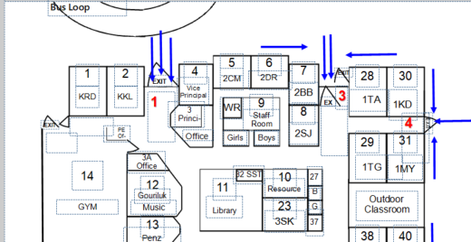
The next 75 minutes
6:00pm – 7:15pm
3 sessions (gym, library, Kindergarten Room)
Groups 1, 2 and 3
6:55pm – 7:15pm
Questions in the gym
Music Room
Notes:
Cyndi

Slide 4
WR Philosophy
At WR School, our Kindergarten Program focuses on:
Focusing on the social and emotional health of all students.
Fostering play and fine motor skills.
Outdoor Education.
Music Literacy.
We have a very inclusive environment.
This carries through grade 4………and beyond.
Notes:
Cyndi

Slide 5
How to Register???
Register Online by visiting our website (you can also register in person or contact the office 204-488-4245):
Complete the registration form and email it to Whyte Ridge School.
Attach your child’s birth certificate.
Proof of residency is required (lease agreement, mortgage documents, or a utility bill).
For newcomer families to Canada (not permanent residents) please see someone in the office (or call 204-488-4245)…..
Notes:
Mike

Slide 6
How to Register???
Morning or Afternoon?
We cannot accommodate everyone (but we try).
We may have to shuffle people around in May/June.
Factor in bussing requests.
Morning starts at 8:25am until 11:10am
Afternoon starts at 12:15pm until 3:00pm
Notes:
Mike

Slide 7
Student Services
Whyte Ridge School works hard to meet the needs of all children:
Clinical Services may be available for Consultation
Pembina Trails Philosophy of Inclusive Practice
Resource, Counselling and English as an Additional Language.
Notes:
Cyndi

Slide 8
Student Services
If you feel like your child may need extra supports or if they have received preschool services please make note of that on your registration form.
Notes:
Cyndi

Slide 9
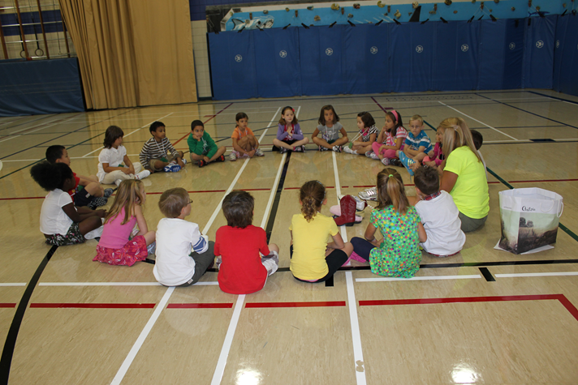
Whyte Ridge School Programming
K-4 English Instructional Program
Music, Gym, Library and French specialists.
Enrichment and STEM Opportunities.
Student interventions.
Participate in school-wide events; such as assemblies, presentations, theme days, etc.
Notes:
Mike

Slide 10
Daycare
There are five school-age daycares serving our school (brochures and information to be emailed to families)
YM/YWCA (WR)
Brightling Academy
Advantage Childcare
Tae-Ryong Park Academy
Fort Garry Child Care Centre (HGI)
Notes:
Mike

Slide 11
Transportation
We have many students who take the bus. For more information on transportation we ask that parents go to the Pembina Trails School Division transportation website:
Find out if you are eligible.
Timelines for registration.
At Whyte Ridge School, we communicate effectively with our families, to ensure that students get to and from school safely.
Notes:
Cyndi

Slide 12
PAC – Parent Advisory Council
Meetings take place on the first Wednesday of the month (September – May):
A chance to meet other parents and get involved in the community.
A shared voice.
Fundraising and staff support.
Transparency and communication
Notes:
Cyndi

Slide 13
Notes:
Mike

Slide 14
Questions???
Notes:
Mike

