Slide 1
Welcome!!! Whyte Ridge Open House February 1st, 2024
To know how to register
To know how to prepare for Kindergarten
To learn about the morning or afternoon in the life of a Kindergartener

Slide 2
Welcome to Kindergarten

Slide 3
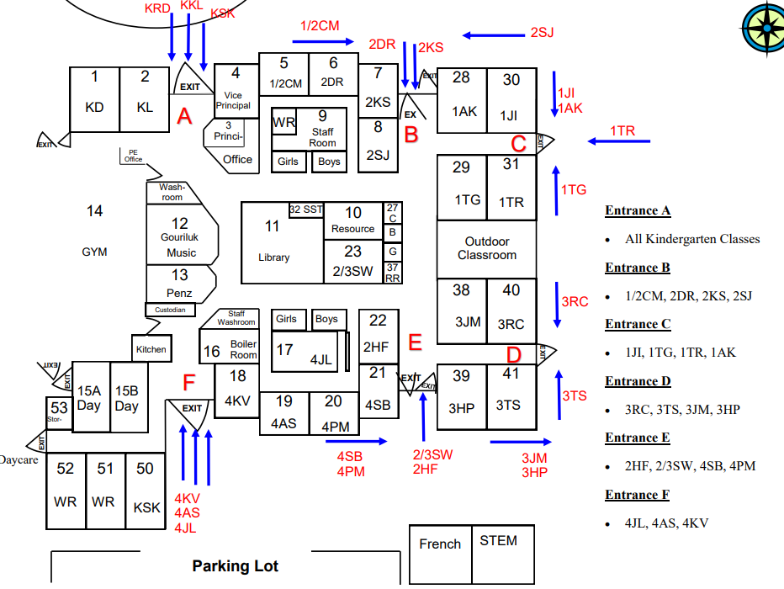
The next 75 minutes
6:40pm – 7:25pm
3 sessions (gym, library, Kindergarten Room)
Groups 1, 2 and 3
7:25pm – 7:45pm
Questions

Slide 4
WR Philosophy
At WR School, our Kindergarten Program focuses on:
Focusing on the social and emotional health of all students.
Fostering play and fine motor skills.
Outdoor Education.
Music Literacy.
We have a very inclusive environment.
This carries through grade 4………and beyond.

Slide 5
How to Register???
Register Online by visiting our website (you can also register in person or contact the office 204-488-4245):
Complete the registration form and email it to Whyte Ridge School.
Attach your child’s birth certificate.
Proof of residency is required (lease agreement, mortgage documents, or a utility bill).
For newcomer families to Canada (not permanent residents) please see someone in the office (or call 204-488-4245)…..

Slide 6
How to Register???
Morning or Afternoon?
We will try and accommodate everyone.
We may have to shuffle people around in May/June.
Factor in bussing requests.
Morning starts at 8:25am until 11:10am
Afternoon starts at 12:15pm until 3:00pm

Slide 7
Student Services
Whyte Ridge School works hard to meet the needs of all children:
Access to SLP, OT, PT and a psychologist through Pembina Trails Student Services.
Pembina Trails Philosophy of Inclusive Practice
Resource, Counselling and English as an Additional Language.

Slide 8
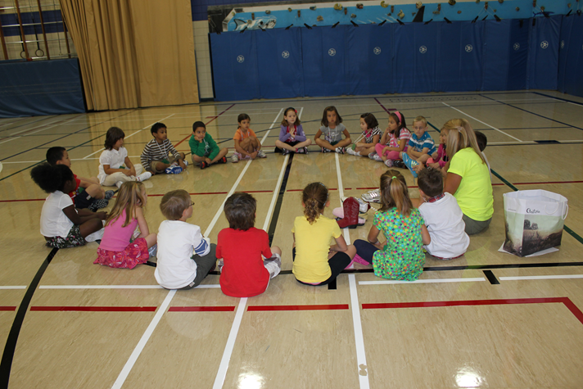
Whyte Ridge School Programming
K-4 English Instructional Program
Music, Gym, Library and French specialists.
Enrichment and STEM Opportunities.
Student interventions.
Participate in school-wide events; such as assemblies, presentations, pyjama days etc.

Slide 9
Daycare
There are five school-age daycares serving our school.
YM/YWCA (WR)
Brightling Academy
Advantage Childcare
Tae-Ryong Park Academy
Fort Garry Child Care Centre (HGI)

Slide 10
Transportation
We have many students who take the bus. For more information on transportation we ask that parents go to the Pembina Trails School Division transportation website:
Find out if you are eligible.
Timelines for registration.
At Whyte Ridge School, we communicate effectively with our families, to ensure that students get to and from school safely.

Slide 11
PAC – Parent Advisory Council
Meetings take place on the first Wednesday of the month (September – May):
A chance to meet other parents and get involved in the community.
A shared voice.
Fundraising and staff support.
Transparency and communication

Slide 13
Questions???

