Slide 1
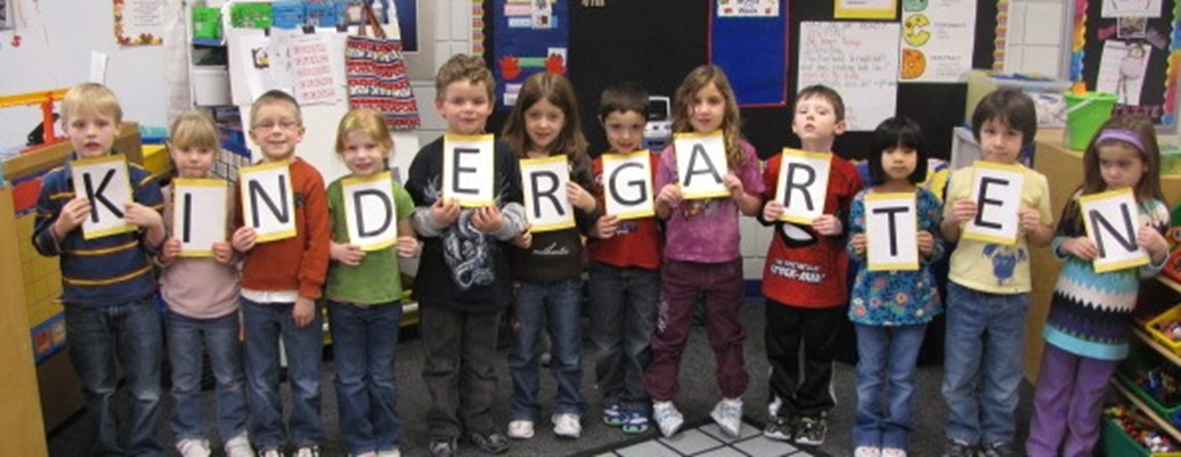
Welcome to The Wonderful World of

Slide 2
What does a regular half day Kindergarten look like?

Slide 3
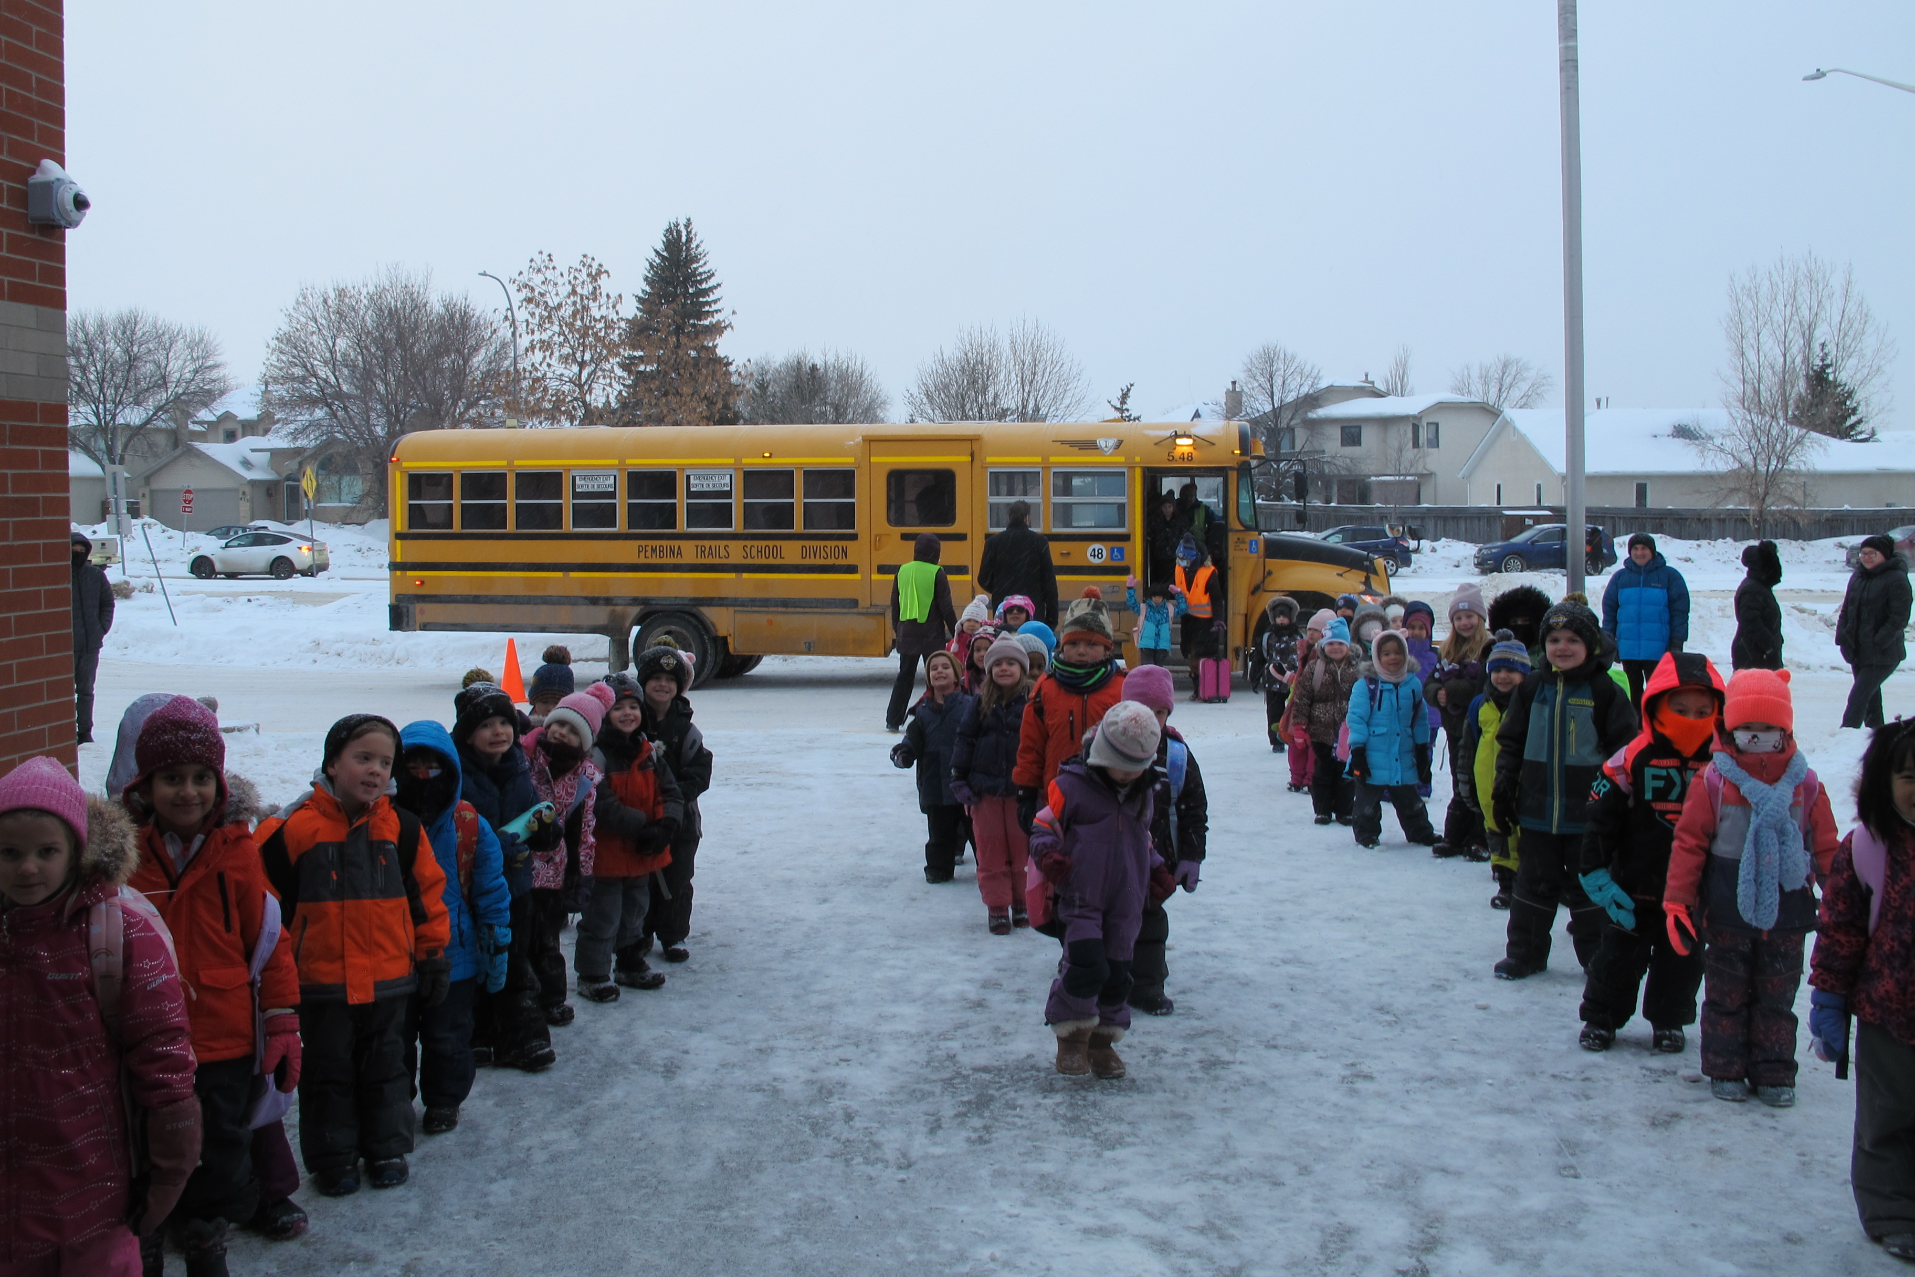
We meet the children at the Flagpole.

Slide 4
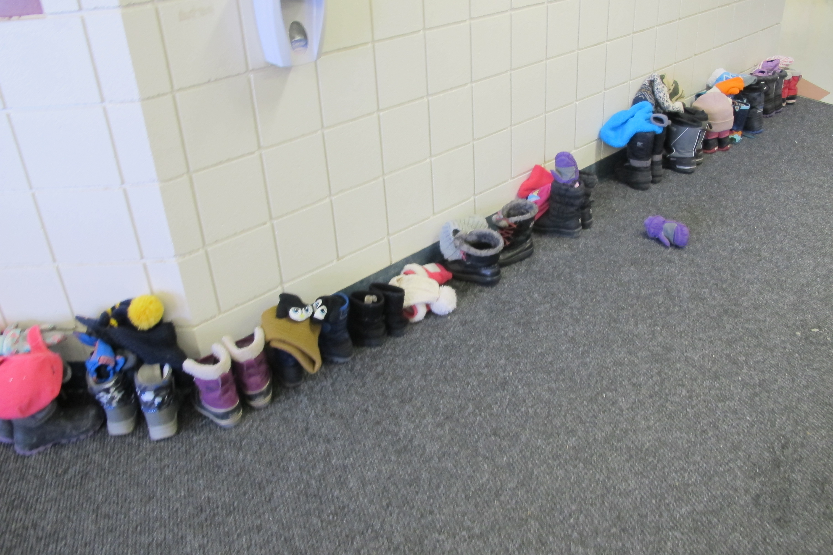
They come into the school and remove outdoor shoes/boots. Then come into the classroom and get ready for the day. They hang up their backpacks and jackets and then put on their indoor shoes.
Independence / routines
Shoes and Velcro (shoes to show)
Backpack
Label clothing (look at the lost and found on the way out)

Slide 5
Visual Schedule
O Canada
Land Acknowledgments
Announcements
Attendance
Children thrive on routines. We work on daily routines in September that carry us through the year. Arriving on time and consistent attendance are important parts of routines.

Slide 6
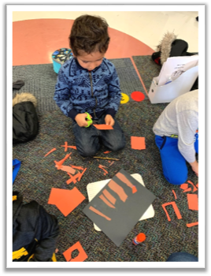
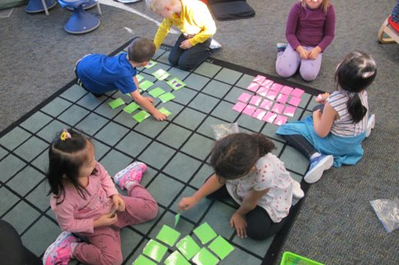
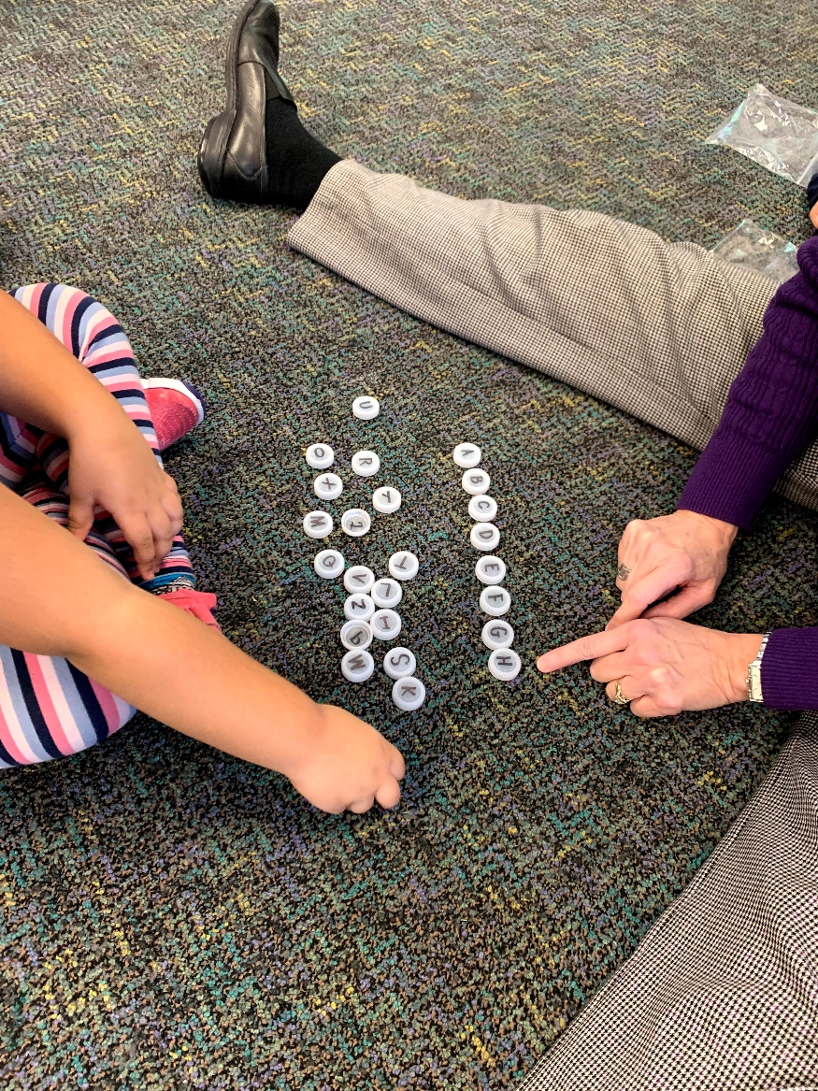
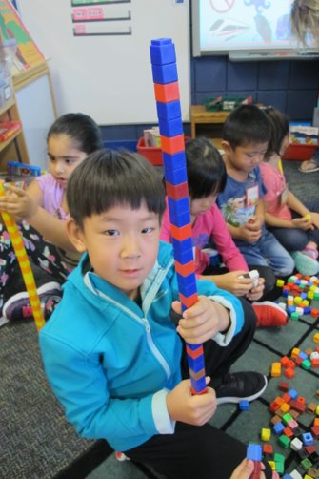
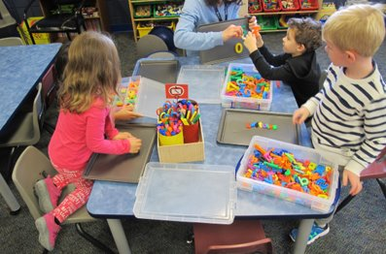
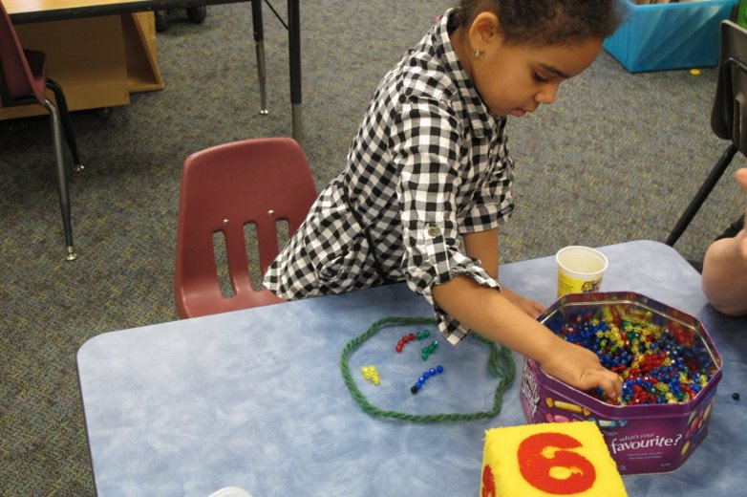
Our job of the day varies depending on what we are working on:
Alphabet Work
Number Work
Phonemic Awareness
Cutting / gluing
Fine motor
Listening Activities
Songs and movement
Following Directions

Slide 7
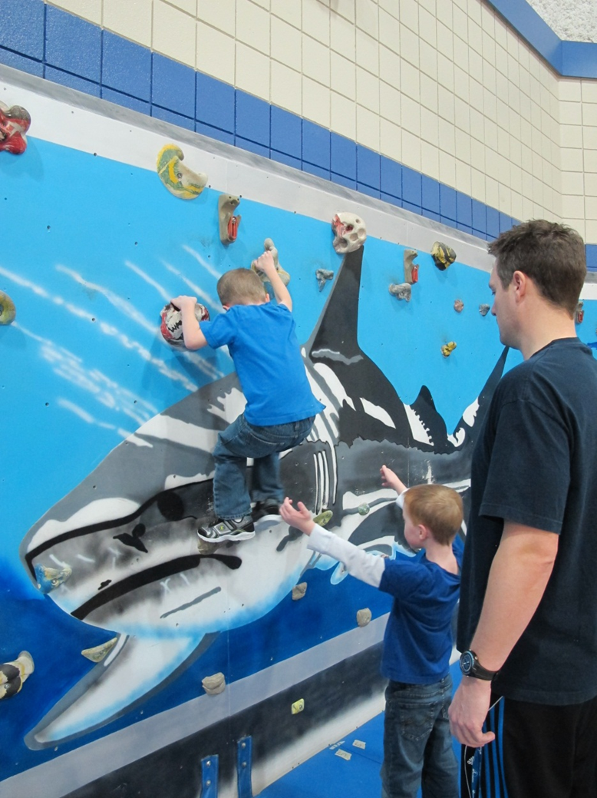
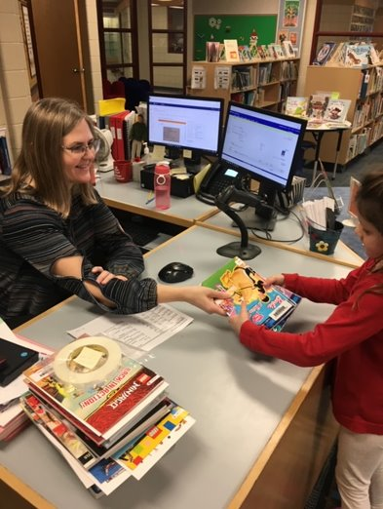
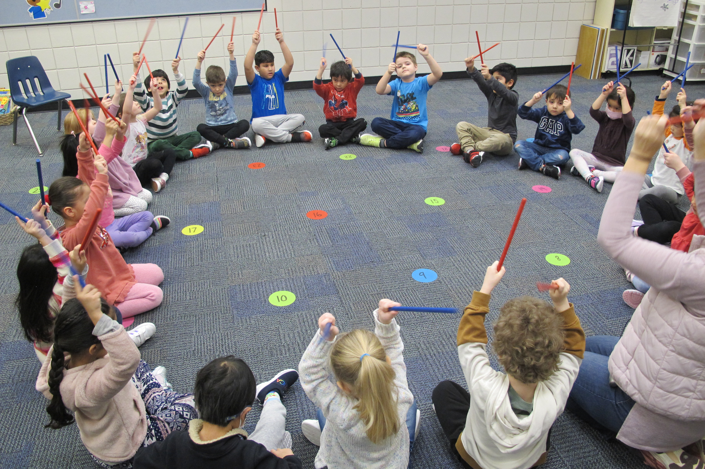
Specialists
Gym three times a cycle
Music two times a cycle
Library once a cycle (responsibility)

Slide 8
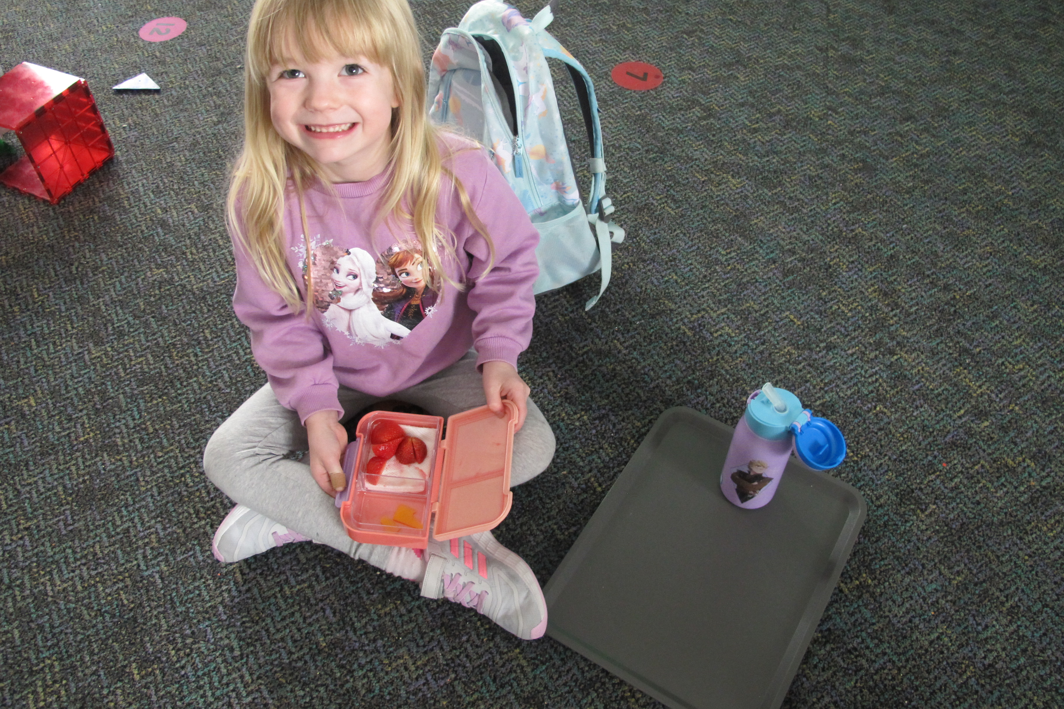
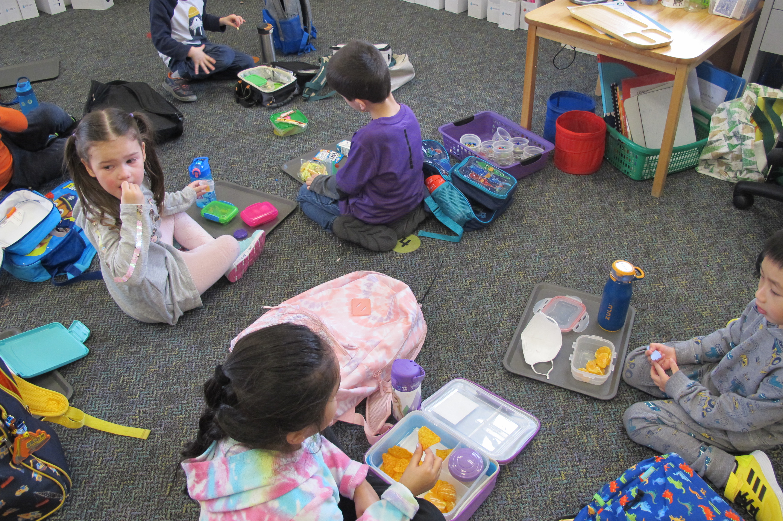
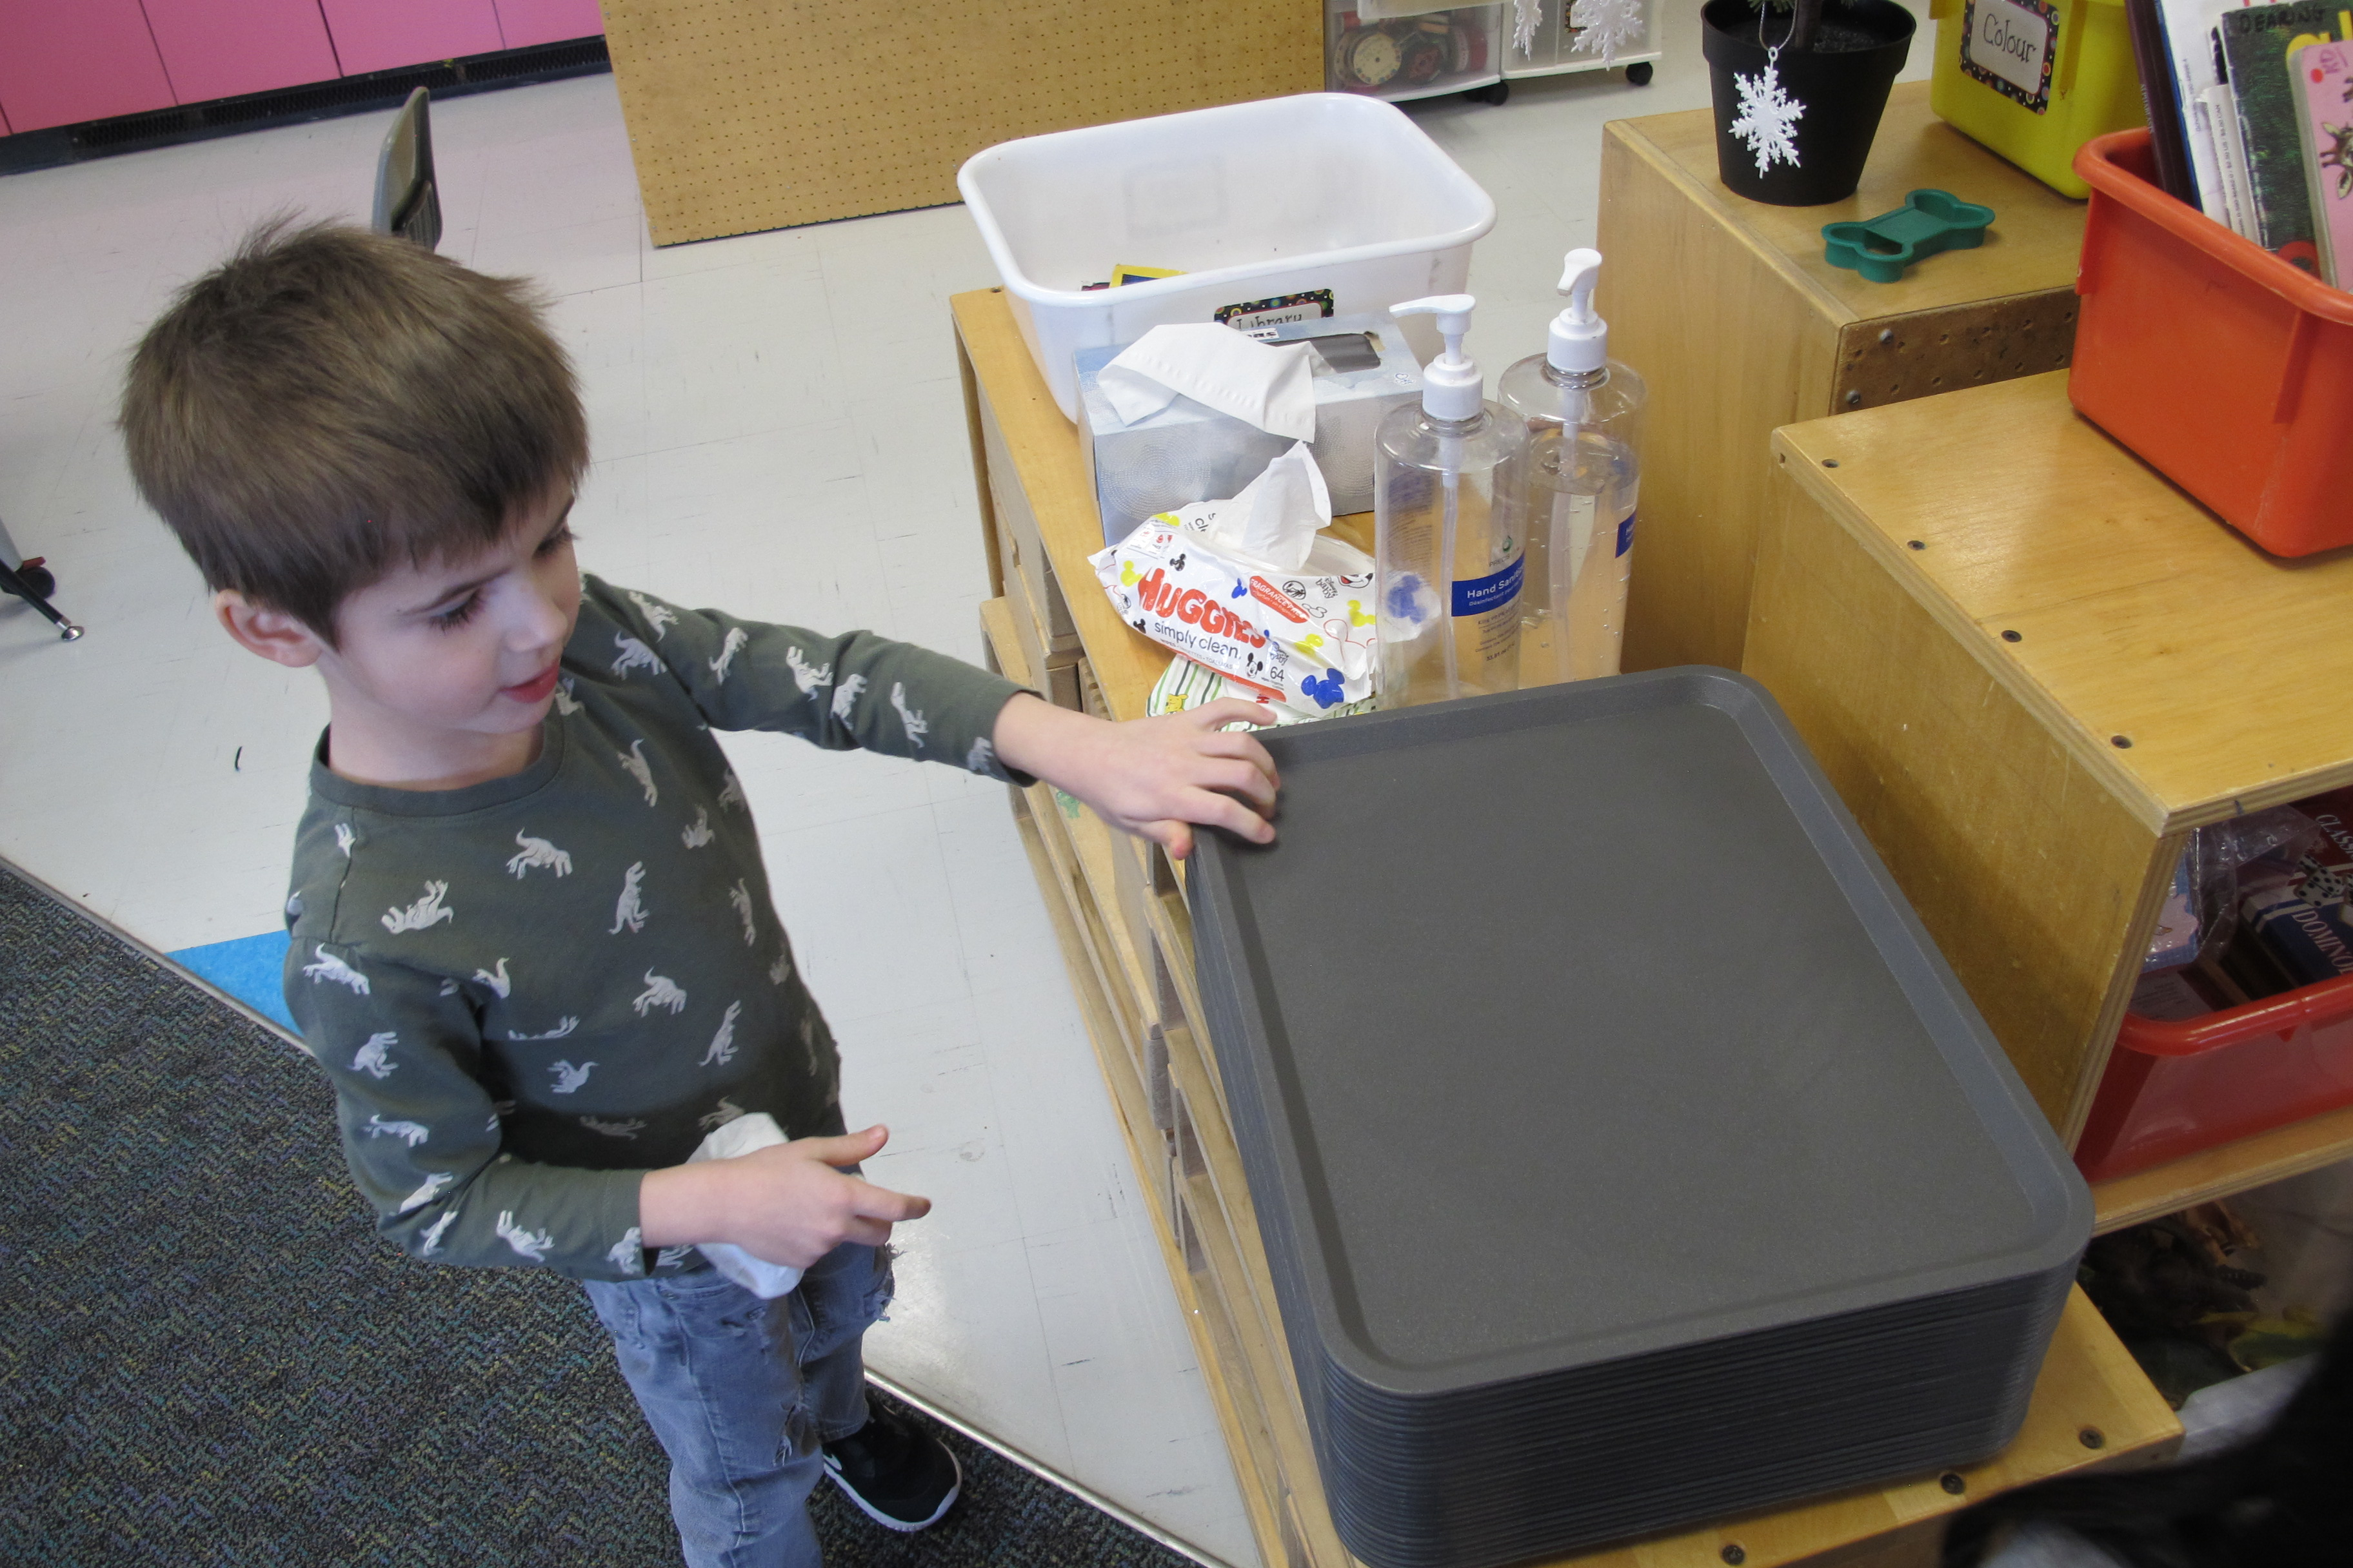
Snack and chat and story time
healthy snacks please
not a lunch
Water bottle

Slide 9
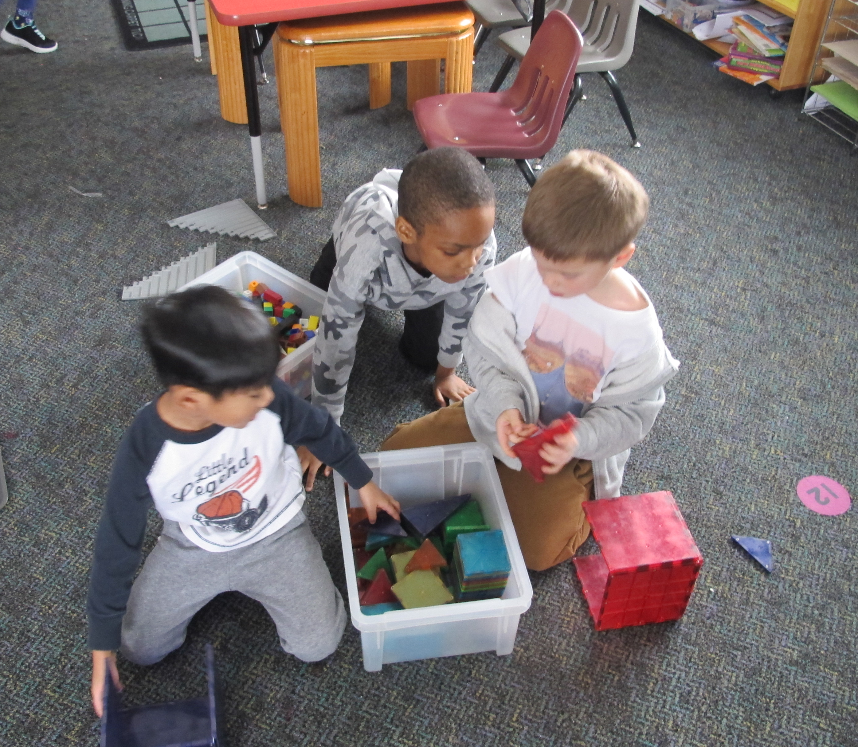
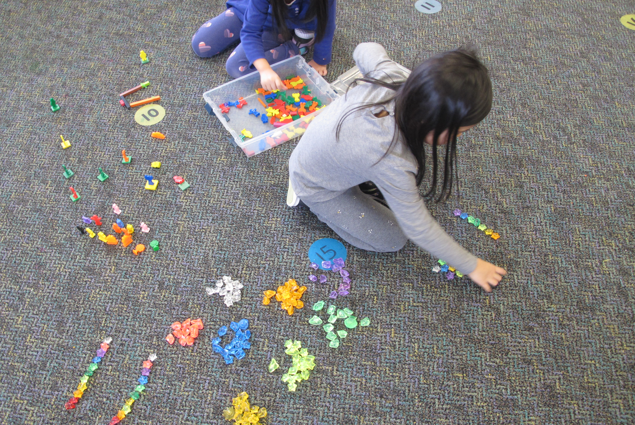
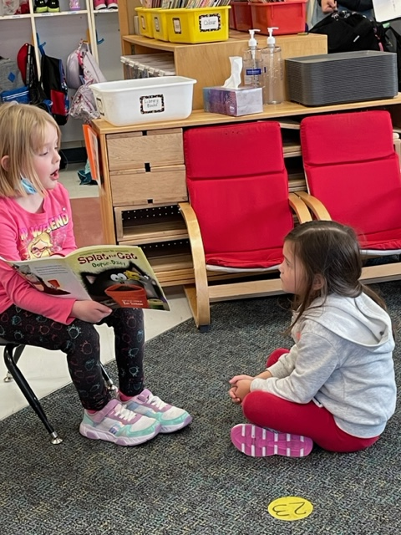
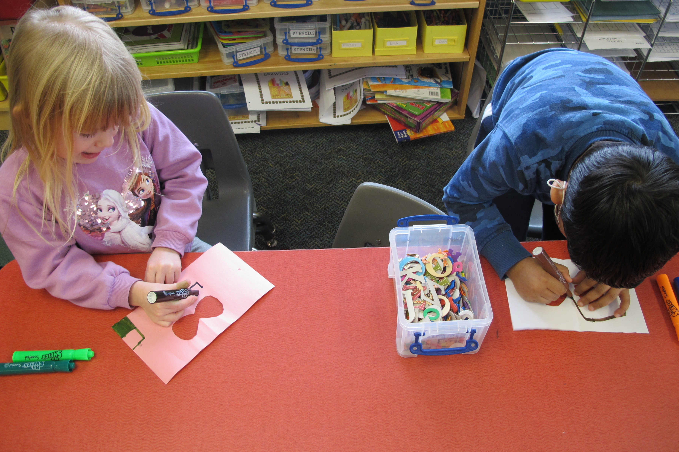
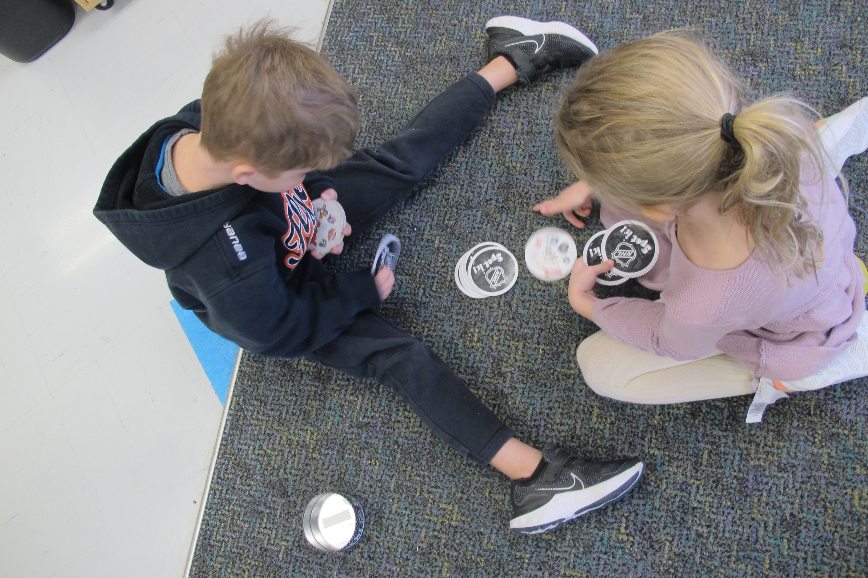
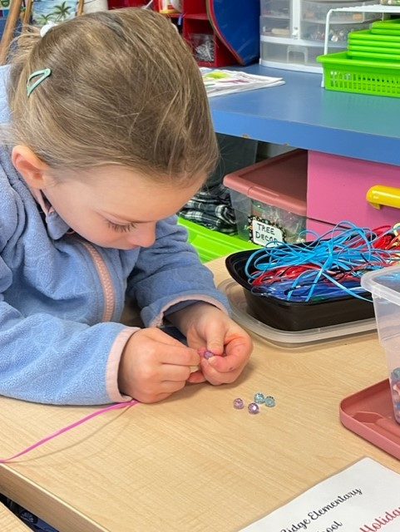
Playtime 30 – 40 minutes every day is our goal –sometimes it’s inside, sometimes it’s outside
Sharing
Kindness
Exploring
Problem Solving
Taking care of materials
Cleaning up

Slide 10
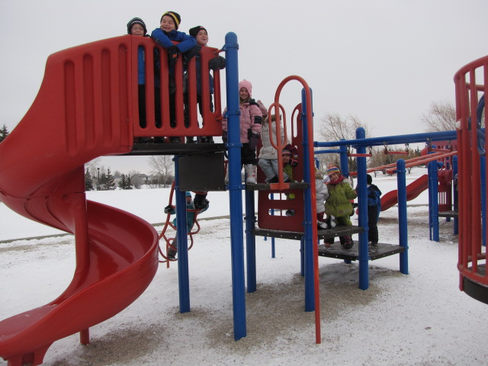
Last half hour of the day
Short jobs:
Mystery Riddles
Story
Games
Outdoor Structure
Getting ready for home

Slide 11
Dismissal
Bussing
Daycare
Family member pick up
Bell times – 8:20/ 11:10 and 12:10 / 3:00
Late – check in at the office

Slide 12
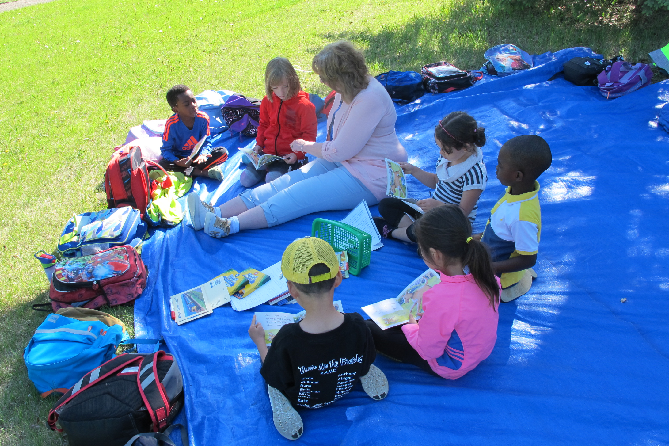
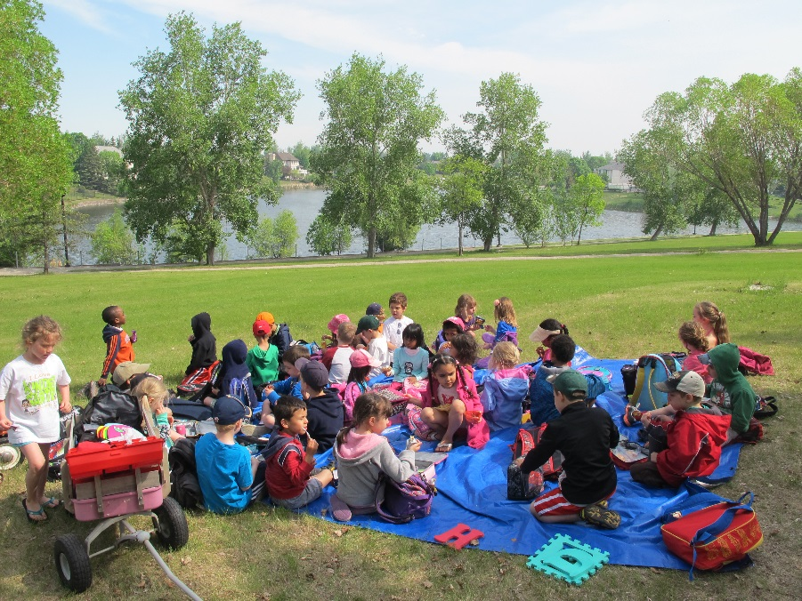
In June we take our classroom outside.

Slide 14
Questions ?
Notes:
hi

