Slide 1
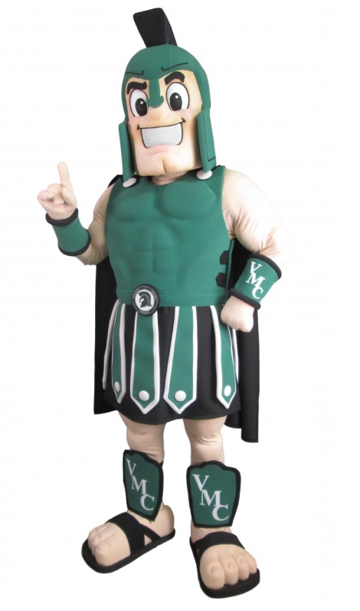
Institut collégial Vincent Massey Collegiate Planning for Grade 12
A guide to choosing the right courses for you

Slide 2
High School at a Glance
​ | Grade 9​ |  | Grade 10​ |  | Grade 11​ |  | Grade 12​
English​ | ELA10F​ | ELA10F​ | ELA10F​ | ELA20F​ | ELA30S​ (choice)​ | ELA30S​ (choice)​ | ELA40S​ (Choice)​ | ELA40S​ (Choice)​
Français​ | ​ | XFR10F​ | ​ | XFR20F​ | ​ | XFRLC30S​ | ​ | XFRLC30S​
Physical Ed.​ Éd. physique​ | PE10F​ | XEP10F​ | PE20F​ | XEP20F​ | PE30F​ | XEP30F​ | PE40F​ | XEP40F​
Math​ Mathématiques​ | MAT10F​ | XMAT10F​ | MATH 20S​ (Choice)​ | XMATH 20S​ (Choice)​ | Math 30S​ (Choice)​ | XMath 30S​ (Choice)​ | Math 40S​ (Choice)​ | XMath 40S​ (Choice)​
Social Studies​ Sciences humaines​ | SSCCW10F​ | XSSCCW10F​ | GEOIC20F​ | XGEOIC20F​ | HIS30F​ | XHIC30F​ | ​ | ​
Science​ Sciences de la nature​ | SCI10F​ | XSCI10F​ | SCI20F​ | XSCI20F​ | ​ | ​ | ​ | ​
Thinking & Learning​ Penser & apprendre​ | RIT10S​ | RIT10SFI​ | ​ | ​ | ​ | ​ | ​ | ​
​ | 4 options​ | 3 options​ | 3+ options​ | 2+ options​ | 2+options​ | 1+option​ | 2+option​ 3 –univ.​ ​ | 1+option​ 2-univ.​
30 credits in total

Slide 3
Diploma Options
Manitoba Provincial Diploma
30 credits – required & optional combined
French Immersion Provincial Diploma
14 FI credits
French Immersion Enrichi Diploma
20 FI credits
French Immersion Approfondi Diploma
22 FI credits
Vincent Massey UNESCO Diploma
Awarded to students who contribute to the UNESCO Pillars and Study Areas through a Take Action Project

Slide 4
What Grade 12 courses do you NEED?
ELA40S Focus Course
(Comprehensive, Literary or Transactional Focus)
Math40S / Mathé40S
(Applied, Essentials, PreCalculus)
PE40F/EP40F
(75/25; 50/50; Outdoor Ed, Bball, Vball, Football, Female Fitness, Male Fitness
2 optional courses to graduate + 1 to go to University
Français40S
Courses in GREEN are also offered in French
Please check websites of prospective Universities for required courses.
Notes:
The majority of students acquire more than 30 credits

Slide 5
What options can you take?
Course Description Guide

Slide 6
Optional Courses That Don’t Have a Pre-requisite
Business Management 40S
Cinema as a Witness to Modern History 40S
Economic Principals 40S
Family Studies 40S
First Nations, Metis & Inuit Studies 40S
Food and Nutrition 40S
Global Issues 40S / Enjeux mondiaux 40S
History of Western Civilization 40S
Law 40S
Life/Work Transitions 40S
Psychology 40S / Psychologie 40S
Missing from course selection sheet:
Introduction au calcul et mathématiques avancés 40S (XICAM(1)40S)

Slide 7
Dual-Credit Courses
University based dual-credit courses:
U of W Calculus & Adv. Math II 42U
U of W Chemistry 42U
Advanced Placement Courses
English Literature: Advanced Placement 42S
Psychology Advanced Placement 42S

Slide 8
Which optional courses should you choose?
Courses that you are interested in
Courses that are prerequisites for programs you are interested in
Each College or University program has different entrance requirements. It is important that you do your research and know what they are.
If unsure, please check with your counsellor.

Slide 9
Scholarships & Awards
Eligibility and application criteria vary, so be sure to read the requirements carefully.
May be based on marks, extra-curricular activities, heritage, field of study, child of employee at certain companies, essay-writing contest winner, etc.
Most entrance scholarships are based on demonstrated academic excellence in the last one or two years of high school.
https://www.pembinatrails.ca/vincentmassey/page/2175/scholarship-and-bursary-website

Slide 10
Current Scholarships for Grade 11 Students
Horatio Alger Canadian Scholarship Program
($10,000 & $5000) – Due March 15, 2024
Financial Need
Perseverance & integrity in overcoming personal adversity
Will pursue a university degree & Canadian citizenship
Graduating 2025
Manitoba School Boards Association
Student Citizenship Award ($1000) – Due April 5, 2024
Volunteer service to community
Citizenship or character-building organizations
Student government activities
Leadership, motivate others to action

Slide 11
Questions?

