Slide 1
Institut collégial Vincent Massey Collegiate Planning for Grade 11
A guide to choosing the right courses for you

Slide 2
What courses do you need to graduate?
Grade 11:
ELA (ELALF30S, ELACF30S, ELATF30S, ELA30LFSH)
Math (MPC30S, MPC30SH,MAP30S, MES30S)
Physical Education (PE30F or PE academies)
History of Canada (HIS30F)
(students typically earn 8-10 credits each year)
Grade 11 French Immersion:
ELA (ELALF30S, ELACF30S, ELATF30S, ELA30LFSH)
Math (XMPC30S, XMPC30SA,XMAP30S, XMQ30S)
Education Physique(XEP30F or PE academies)
Histoire du Canada(HIS30F)
Français (XFR30F)
Notes:
The majority of students acquire more than 30 credits

Slide 3
High School at a Glance
​ | Grade 9​ |  | Grade 10​ |  | Grade 11​ |  | Grade 12​
English​ | ELA10F​ | ELA10F​ | ELA10F​ | ELA20F​ | ELA30S​ (choice)​ | ELA30S​ (choice)​ | ELA40S​ (Choice)​ | ELA40S​ (Choice)​
Français​ | ​ | XFR10F​ | ​ | XFR20F​ | ​ | XFRLC30S​ | ​ | XFRLC30S​
Physical Ed.​ Éd. physique​ | PE10F​ | XEP10F​ | PE20F​ | XEP20F​ | PE30F​ | XEP30F​ | PE40F​ | XEP40F​
Math​ Mathématiques​ | MAT10F​ | XMAT10F​ | MATH 20S​ (Choice)​ | XMATH 20S​ (Choice)​ | Math 30S​ (Choice)​ | XMath 30S​ (Choice)​ | Math 40S​ (Choice)​ | XMath 40S​ (Choice)​
Social Studies​ Sciences humaines​ | SSCCW10F​ | XSSCCW10F​ | GEOIC20F​ | XGEOIC20F​ | HIS30F​ | XHIC30F​ | ​ | ​
Science​ Sciences de la nature​ | SCI10F​ | XSCI10F​ | SCI20F​ | XSCI20F​ | ​ | ​ | ​ | ​
Thinking & Learning​ Penser & apprendre​ | RIT10S​ | RIT10SFI​ | ​ | ​ | ​ | ​ | ​ | ​
​ | 4 options​ | 3 options​ | 3+ options​ | 2+ options​ | 2+options​ | 1+option​ | 2+option​ 3 –univ.​ ​ | 1+option​ 2-univ.​

Slide 4
What do these course codes mean?
Grade 9 10F or 10G
Grade 10 20S, 20G, 20F, 20SH, 20SA
Grade 11 30S, 30G, 30F, 30SH, 30SA
Grade 12 40S, 40G, 40F, 40SH, 40SA
Courses at the different levels can be taken any year as long as the prerequisites are respected.

Slide 5
Which ELA course should you choose?
Grade 11: your choices:
Literary Focus (ELALF30S or ELALF30SH)
Comprehensive Focus (ELACF30S)
Transactional Focus (ELATF30S)
If you took ELALF30SH this year, you would choose ELALF40SH and ELALL40SH.
Notes:
In grade 12 you can change the ELA focus course. All 3 have the same provincial exam.

Slide 6
Which Mathematics/ mathématiques course should you choose?
Pre Cal Math (MPC30S, MPC30SH,
Mathématiques pré-calcul (XMPC30S, XMPC30SA)
Applied Math (MAP30S)
Mathématiques appliquées (XMAP30S)
Essentials Math (MES30S)
Mathématiques au quotidien30S (XMQU30S)
If you took (MPC30SH/ XMPC30SA) this year, you should select Pre-calculus math 40S honours (MPC40SH,XMPC40SA)
Notes:
If you took honours you must also sign up for MPC40

Slide 7
What are your choices for Physical Education/ Education Physique?
If you are going into grade 11,
Phys Ed 30F (PE75-30F) / Education Physique 30F (XEP(75)30F).
You can choose to do one of the 30F sport focus to meet this requirement. Please not that the sport focus courses are not in French.
Basketball Academy (PEBB30F)
Football Academy (PEFB30F)
Volleyball Academy (PEVB30F)
Outdoor Education (PEOE30F)

Slide 8
What Social Studies/Sciences Humaine courses must you complete?
History of Canada (HIS30F)
Histoire du Canada (XHIC30F)

Slide 9
En immersion Francais
Francais (XFRLC30S)

Slide 10
What are your options when it comes to science/Sciences de la nature?
WHY?
It meets a requirement for a post-secondary program of interest
You are interested in science
Biology/ Biologie (BIO30S/XBIO30)
Chemistry/Chimie (CH30S/ XCH30S)
Physics/ Physique (PHY30S/XPHY30S)
If you took any 30SH/30SA science honors/advanceé, you would sign up for the 40 level ( ex. BIO40SH/XBIO40SA)

Slide 11
Important note about courses
If you want to take any of the following:
Advanced Placement Psychology (PSY42S)
Advanced Placement English (LIT42)
University of Winnipeg Chemistry
University of Winnipeg Calculus/ Advanced Mathematics 45II
Ensure that you have the prerequisite

Slide 12
Which optional courses should you choose?
Courses that you are interested in
Courses that lead to required courses for programs you are interested in
Courses that you have never tried before

Slide 13
Plan With the End in Mind How do you start planning for your future?
High school pre-requisites
University/College pre-requisites
University scholarships
Conversations with your guidance counsellor

Slide 14
FUTURE EXPLORATIONS Manitoba Institute of Trades and Technology
Culinary Arts
Hairstyling
Automotive Technology
Welding Technology
Electrical Trades Technology
FUTURE EXPLORATIONS- Tour MITT on February 22 in the PM. Only 35 spots
For more information, please attend a meeting in the library on February 14th at noon. Please see Ms. Vigilance if you are interested in attending Future Explorations but cannot make the presentation.
Note* If students are accepted into a program, they attend Massey in the morning and MITT in the afternoon.

Slide 15
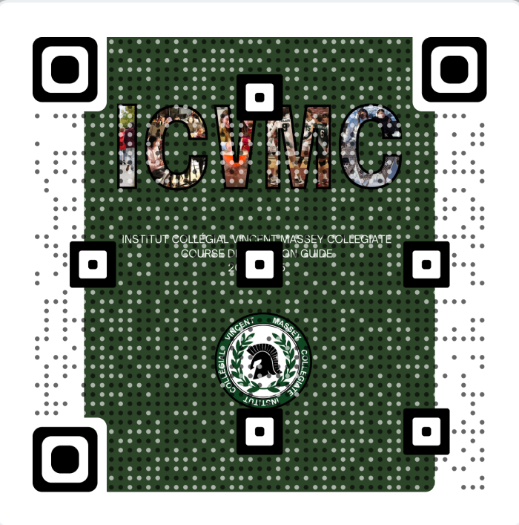
Check out the ICVMC guide! We have so many option courses to choose from.

Slide 16
Questions?

