Slide 1
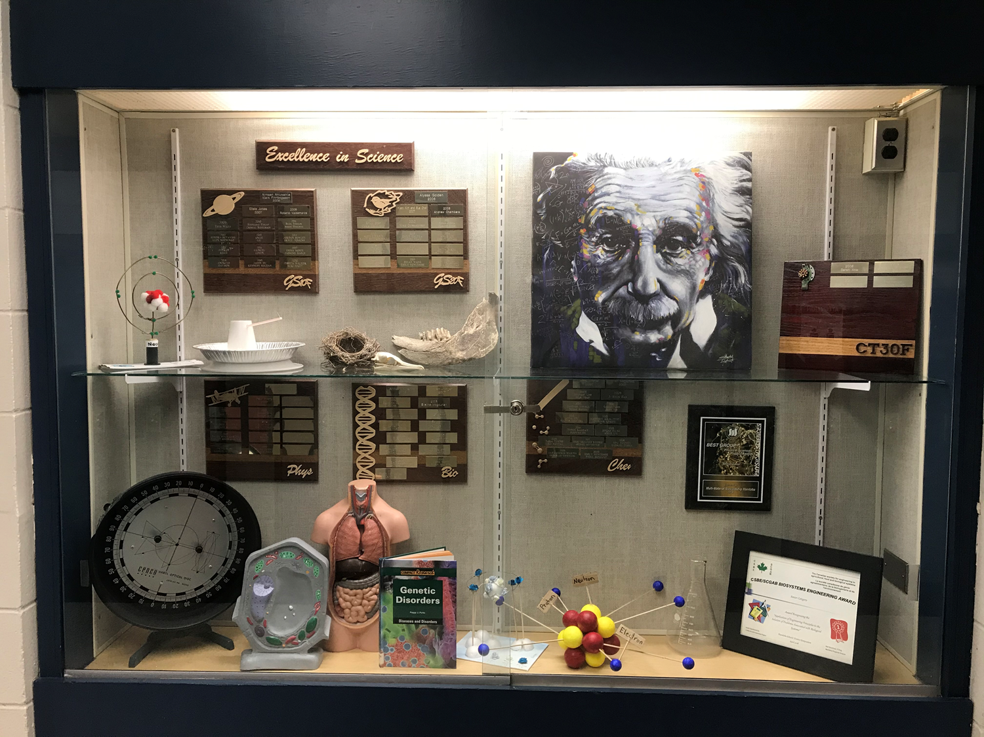
Virtual Open House 2022

Slide 2
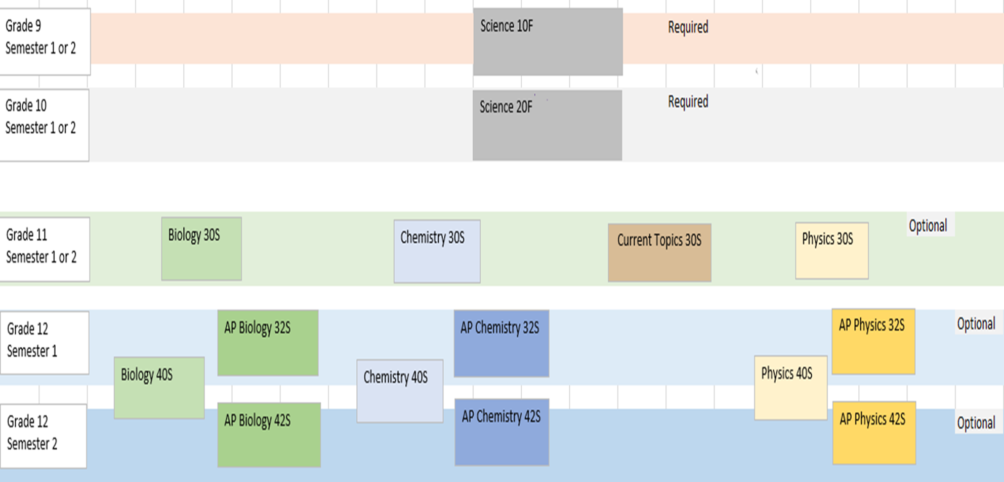

Slide 3
Advanced Placement (AP) Programs
An enriched, challenging, & rigorous academic program
Students will possess a strong work ethic & demonstrated academic success
Prepares students for AP courses & prepares them for university
College-level courses and exams are sponsored by the College Board.
Programs are offered in 65 countries and recognized by approximately 2900 universities

Slide 5
Shaftesbury MSSS 2020/2021 Team:
Leon Spivak (2020 graduate)
Jessica Walker – grade 10
Oban Srinathan – grade 11
Tali Riman – grade 11
Kori Spott – grade 10
Alicia Kee & Aareen Sharma – grade 10

Slide 6
https://csfjournal.com/volume-4-issue-1-1/2021/9/17/predation-pressure-of-jellyfish-on-larval-capelin-in-northeastern-newfoundland

Slide 11
2020

Slide 12
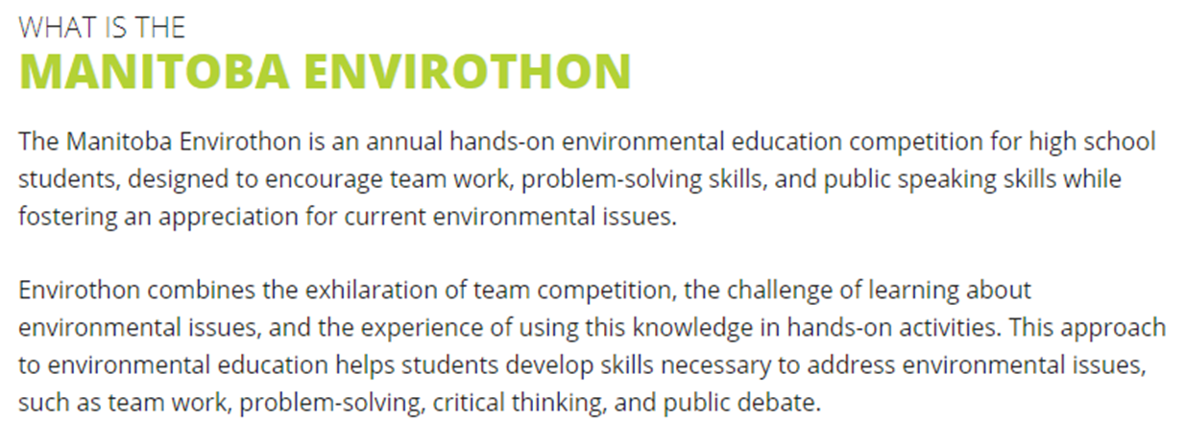
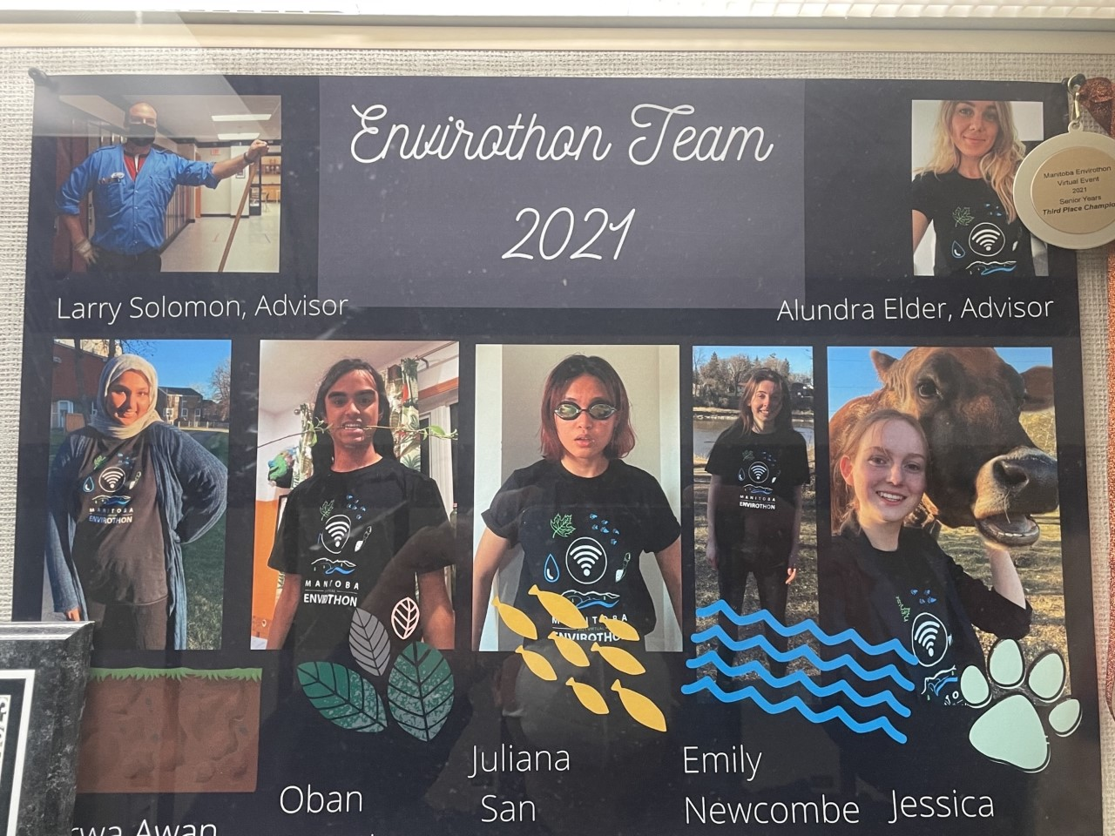
Envronment Testing
Hypothesis
Socio-Economic Impact
Sustainability

Slide 13
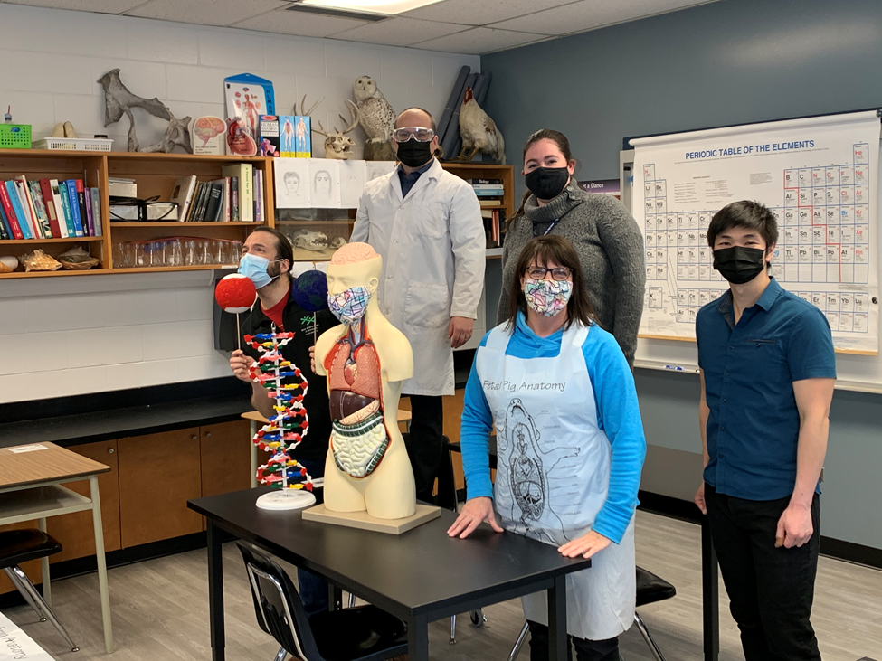
A few of our program highlights. Thank you for your time.

