Slide 1
Ready, Set, Go!
Preparing for
Kindergarten

Slide 2
Kindergarten Today
Kindergarten today may look different from when you were young
Parents are their child's first and most important teacher
Partnership between home and school is essential

Slide 3
It is not ALL about academics!
Gross and Fine Motor Skills
Time to build big and small muscles.
Social Emotional
Time to build skills to get-along with others, taking turns, interacting with peers in a respectful way, dealing with emotions in an appropriate way.
Oral Language
By 4 year old, most people should understand your child most of the time.
Can your child get their needs and wants met through language?
By 5 years old, children should be able to talk in 4-5 word sentences and use the same grammar as the rest of the family!

Slide 4
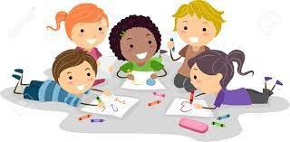
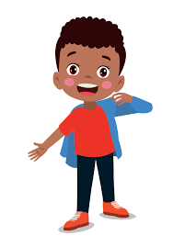
Building Independence
Bathroom and hand washing
Leaving Mom and Dad
Being able to ask for help
Eating a snack independently
Undressing and dressing

Slide 5
Alphabet Skills
Exposure to letters
Alphabet songs
Books about the alphabet
Start off slow
Experience is the goal, not mastery just yet!
Keep it fun!!

Slide 6
Number Knowledge
Exposure to numbers
Number songs
Books about numbers
Start off slow
Experience is the goal,
not mastery just yet!
Recognize the differences between a number and a letter
Oral counting to 31
Play board games, dice games and counting games.

Slide 7
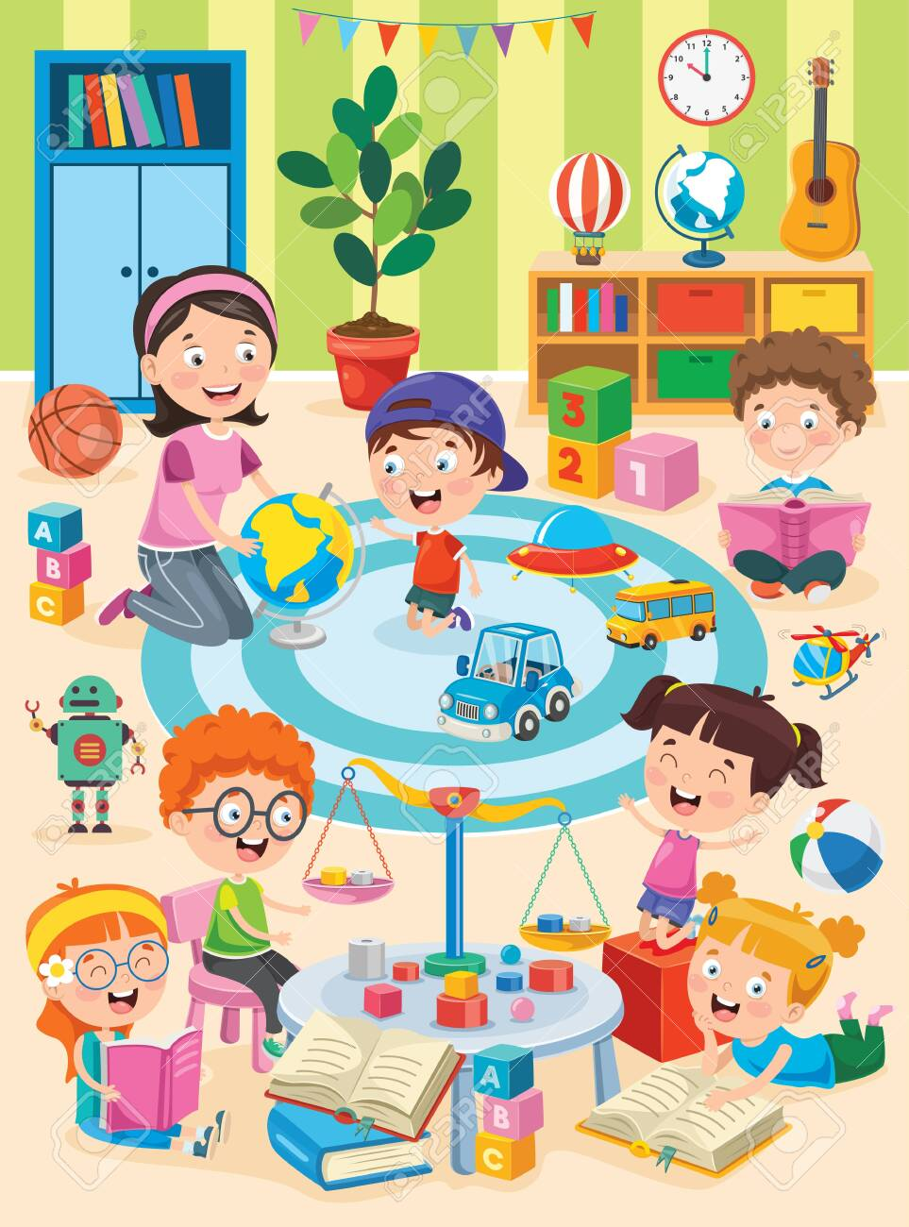
Language Skill Development
Nursery rhymes
Interacting with books
Rhyming games and songs
Rhyming books
Conversation
Play with words and language
Finger play songs
Leisure Guide and Winnipeg Public Library programs
Play dates

Slide 8
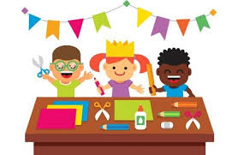
School Readiness Skills
Recognize name in print
Try to print name
Interest in exploring letters and numbers
Ability to sit and listen and attend for 5 – 10 minutes
Follow one step directions
Scissors, glue, pencil, and colouring skills
Board games, card games, dice game & pen and paper games (tic tac toe)

Slide 9
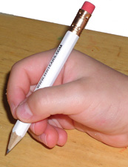
A correct pencil grip is necessary to support printing and other fine motor skills. This skill is very important in Kindergarten as it reflects future work.

Slide 10
Speech & Language, Occupational Therapy and Physiotherapy Services
If your child is currently receiving any pre-school services such as Speech & Language, Occupational Therapy or Physiotherapy, please indicate this on your registration form.
It is beneficial to programing to share reports with the school.

Slide 11
Screen Time
Parents can positively influence children’s language, social adaptive skills, sleep patterns, and behaviours by setting limits on family screen time.
Source: Michelle Ponti MD; Canadian Pediatric Society
https://cps.ca/en/documents/position/screen-time-and-preschool-children

Slide 12
Model Healthy Screen Time
Prioritize shared family media use (watch TV or movies together, play video games together).
Encourage and participate in activities unrelated to screens, such as shared reading, outdoor play, easy board games, and crafts.
Turn off devices during family time at and away from home.
Turn off screens when not in use and avoid background TV.

Slide 13
The Importance of Play

