Slide 1

A Day in Kindergarten!

Slide 2

Welcome to Kindergarten Registration Information Session

Slide 3


Slide 4
Community or Catchment School
Please use the school locator tool on the website to check if we are the school for your address
https://www.pembinatrails.ca/page/785/school-locator
We are CLOSED to Schools of Choice

Slide 5
About Whyte Ridge School
Kindergarten to Grade Four
570 students
English Program

Slide 6
About Kindergarten
Half-Day Program
Hours
Morning: 8:25am -11:10 a.m.
Afternoon: 12:15pm - 3:00 p.m.
Specialists for Physical Education and Music
School wide events, activities, and concerts

Slide 7
Communication with Families
Edsby – more information will be sent after registrations are complete
Whole School: attendance, weekly communication, school calendar
Classrooms: updates, important information, pictures
Email
Updates from admin and office
Divisional information
Website
Divisional information

Slide 8
Communication with Families
Strong Beginnings – September 24 and 25
Tri-conferences – October and February
Report card – June (one per year for Kindergarten)
Appointments available upon request with teachers and administration

Slide 9
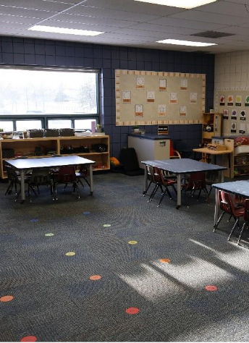
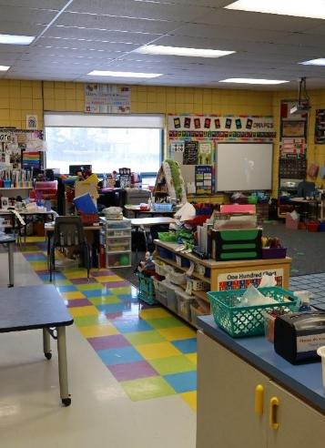
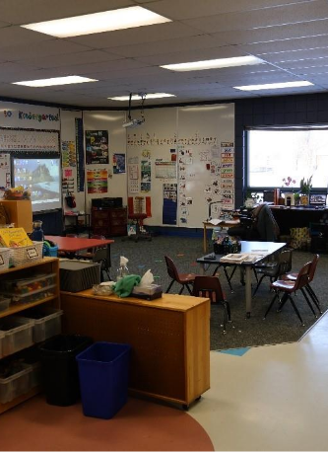
A Day in the Life of Kindergarten

Slide 10
Daily Schedule
O Canada and the Land Acknowledgement
Songs and Movement
Job of the Day
Specialist (Gym, Music or Library)
Snack and Chat
Playtime
Story/Game/Play Structure
Home time

Slide 11
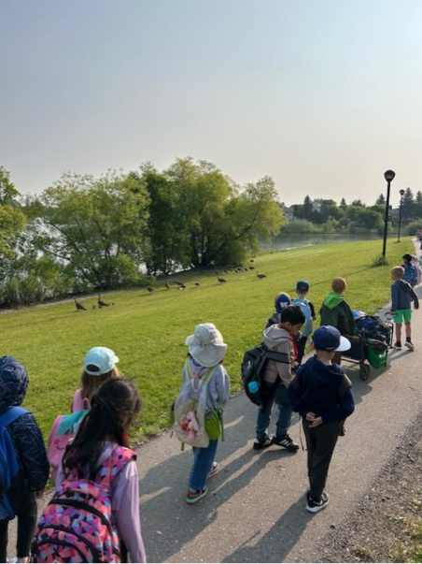
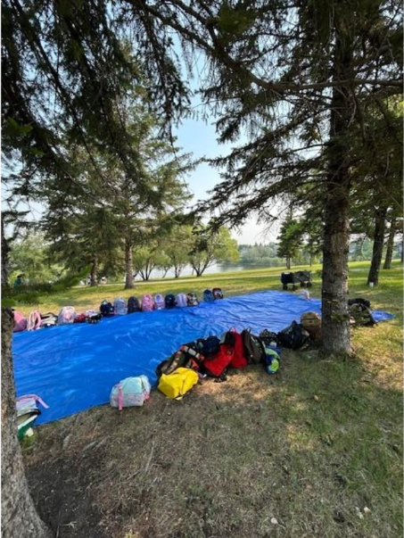
Three hours goes by quickly, but we get a lot done!

Slide 12
How to Register
Register Online by visiting our website (you can also register in person or by contacting the office 204-488-4245):
Complete the registration form
Attach your child’s birth certificate
Provide proof of residency (lease agreement, mortgage documents, or a utility bill)
Email all documents to Whyte Ridge School
For newcomer families to Canada (not permanent residents) please see someone in the office (or call 204-488-4245)

Slide 13
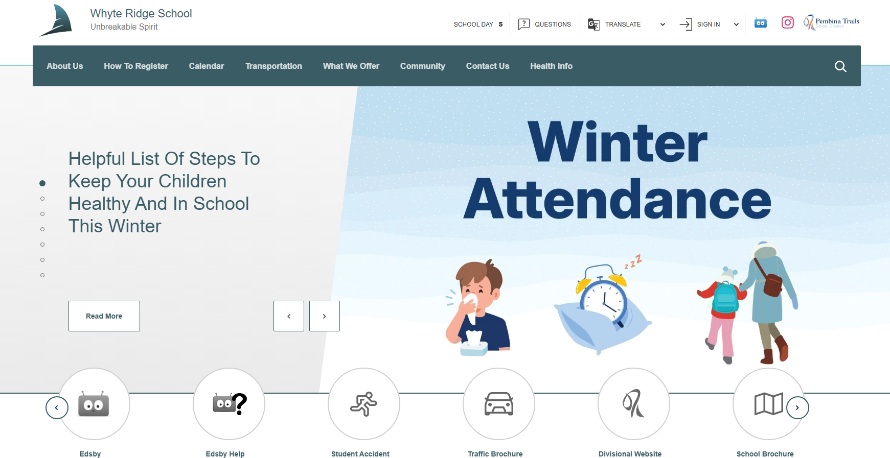
Notes:
Universal
Andrea to present

Slide 14
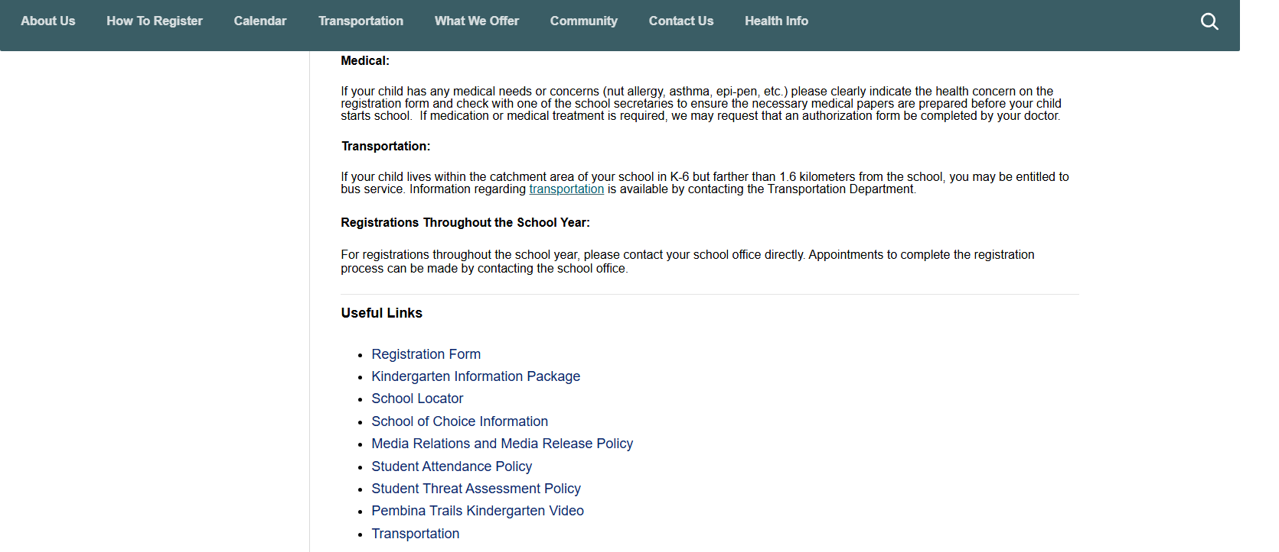

Slide 15
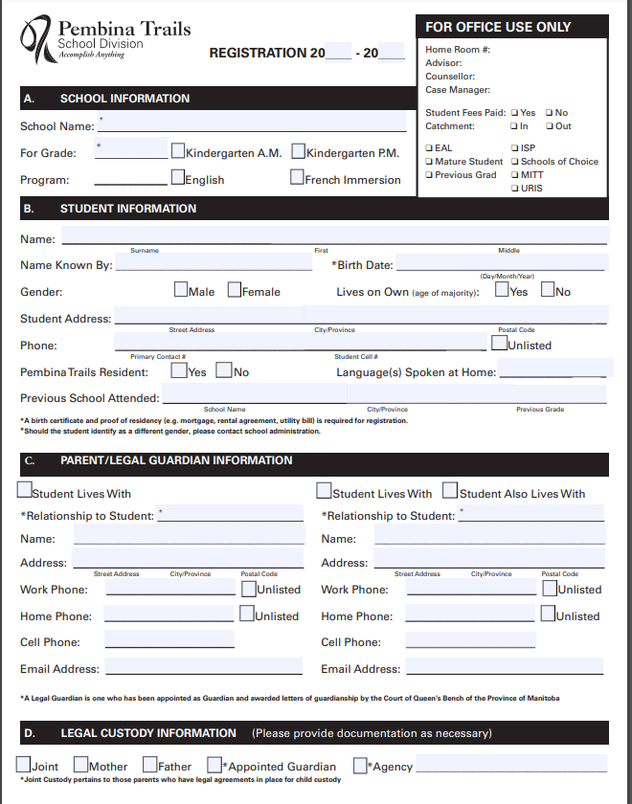
Registration, cont'd
Fill out all sections of the registration form
Please indicate all languages spoken at home, even if not the primary language
It is very important that all information is accurate and up to date
Contact the office with any changes or questions

Slide 16
Timeline
June – Welcome to Kindergarten (WTK)
Class placements – after WTK (including teacher and am/pm)
September – staggered entry
September 24 and 25 – Strong Beginnings
October and February – conferences

Slide 17
Inclusive Practices
Pembina Trails School Division recognizes that today’s classrooms reflect our diverse communities and include a combination of student needs, learning styles and cultural backgrounds. The Division is committed to the rights of all students to participate in educational programming that, within available resources, will maximize the opportunity for students to achieve their individualized learning outcomes.
Child-Centered Teams: Circles of Support Team planning and collaboration between home and school is a critical factor in student success - and we have in place a continuum of supports to assist student learning.

Slide 18
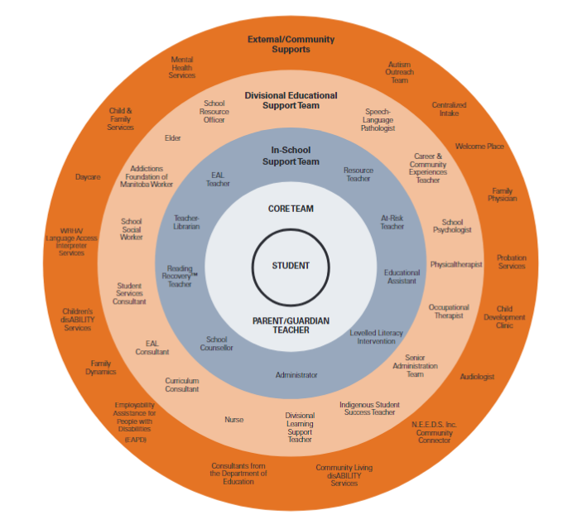
Clinical supports are consultative
Speech and Language Therapist, Occupational Therapist, Physical Therapist, Psychologist, Social Worker

Slide 19
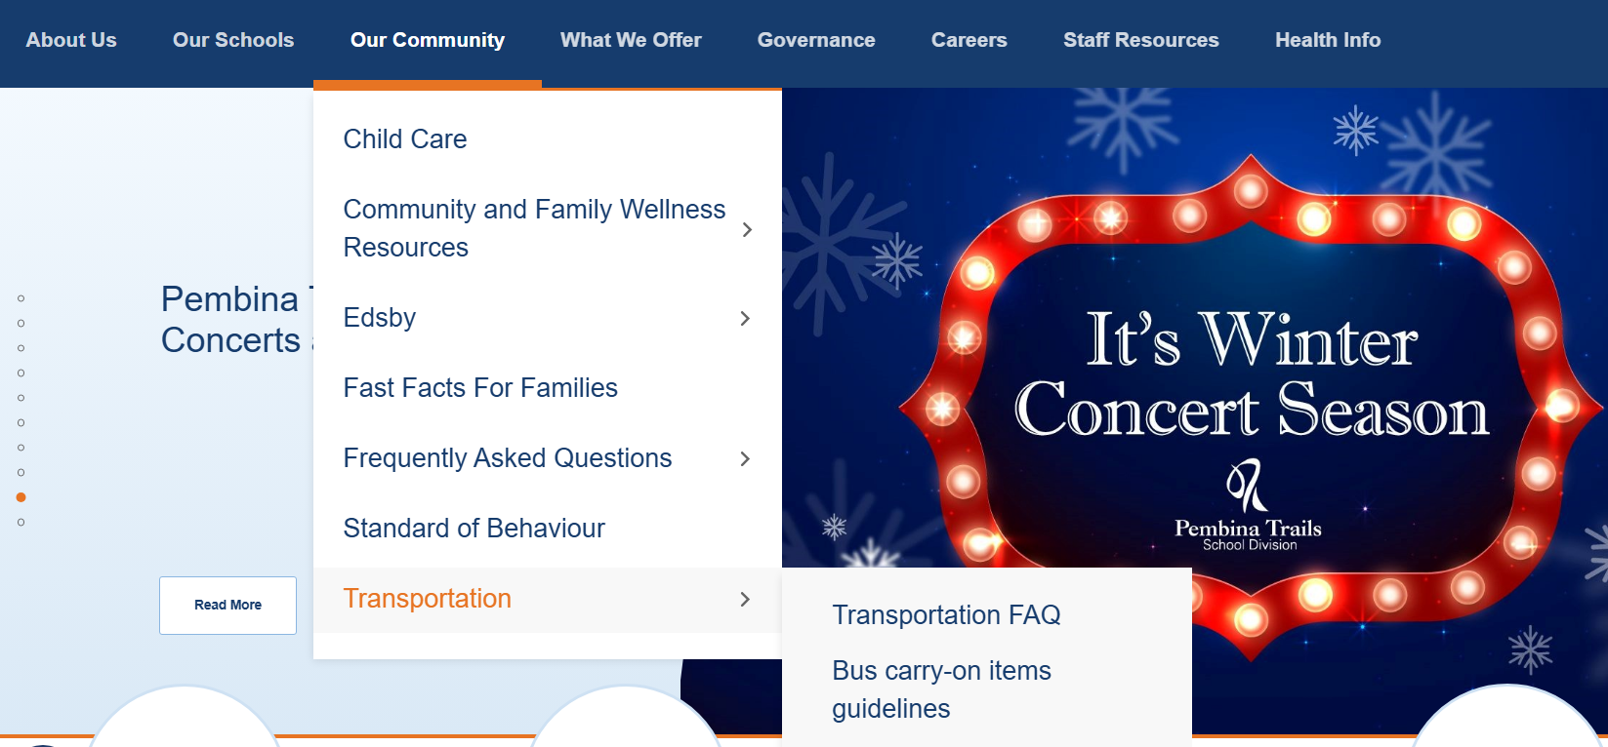
Transportation

Slide 20
Transportation
Available if you are farther than 1.6 km – determined by the Transportation Department
Transportation does not take students to daycare
My Ride App – route information, cancelations, delays, etc.

Slide 21
Parent Advisory Council
Meetings are the first Wednesday of each month, 8 per school year
Fundraising for school initiatives, resources, and classroom supplies (ex. Library furniture, school sign, literacy materials, outdoor education materials, arts and crafts supplies)
School events (Halloween Groove-a-Thon, I Love to Read Book Drive)
whyteridgepac@gmail.com

Slide 22
Daycare Providers
There are five school-age daycares serving our school.
YMCA (WR)
Brightling Academy
Advantage Childcare
Tae-Ryong Park Academy
Fort Garry Child Care Centre (HGI)

Slide 23



Slide 24



Slide 25
FAQs
1. Do you provide snacks?
The school does not provide snacks. We ask families to send a small healthy snack with their child.
2. What are the fees?
Fee amounts will be communicated in June, along with more information.
Families pay a supply fee and an activity fee.
3. My child has additional needs, what do I do?
Please communicate with the school office or indicate on your registration in the medical section. A school team member will contact you to get more information.
4. My child has allergies, asthma, or other medical concerns. What should I do?
Please fill out the medical section. The office will contact you to get more information. You may need to fill out a URIS medical form so our divisional nurse can write up a medical plan to support your child.
5. I may go to another school, should I still register?
If you are unsure of where your child may go (for example) you have applied as a school of choice at another school or private school, we suggest registering at your catchment school as well.

