Slide 1
Welcome
#Where to be? PTC
Notes:
Linda

Slide 2
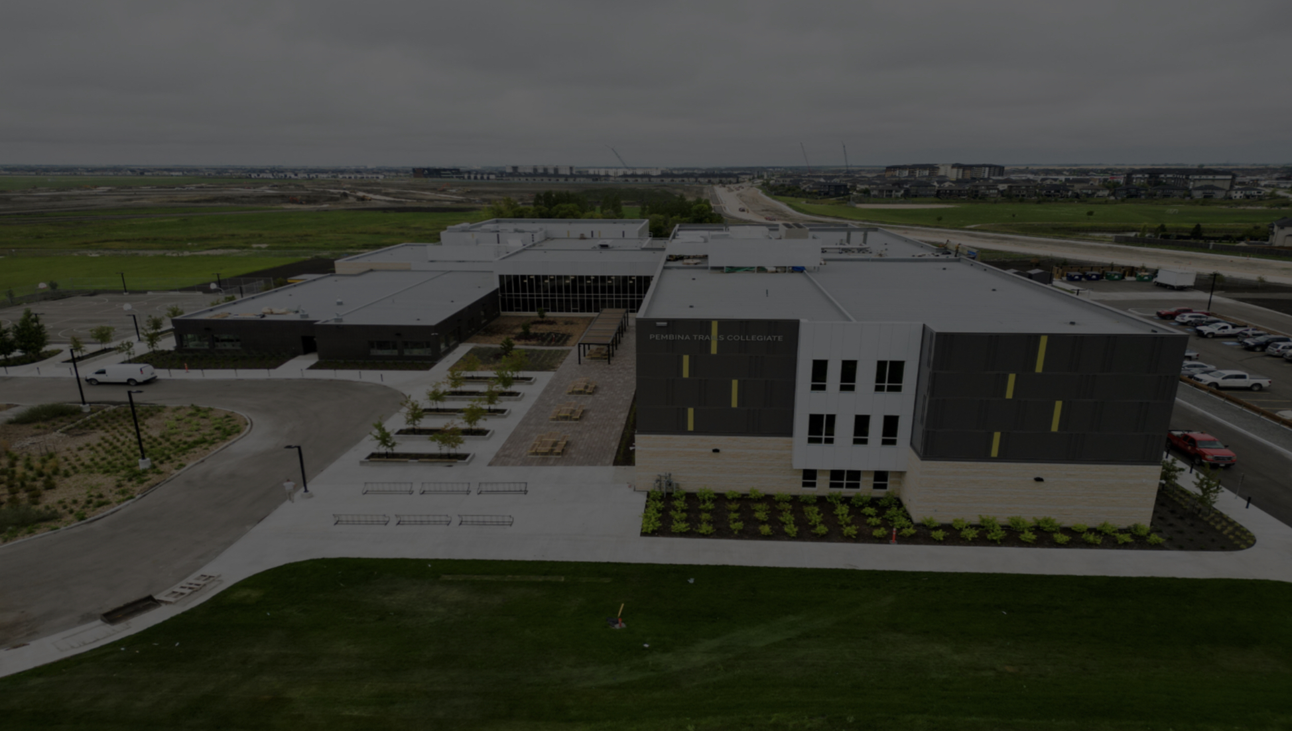
Pembina trails Collegiate​ Grade 9​ Information Session
Notes:
Linda
Welcome to PTC and our presentation specific to incoming grade Nine students and families. We are hoping to provide some additional information about PTC, about high school, transitioning to grade nine and what school looks like.

Slide 3
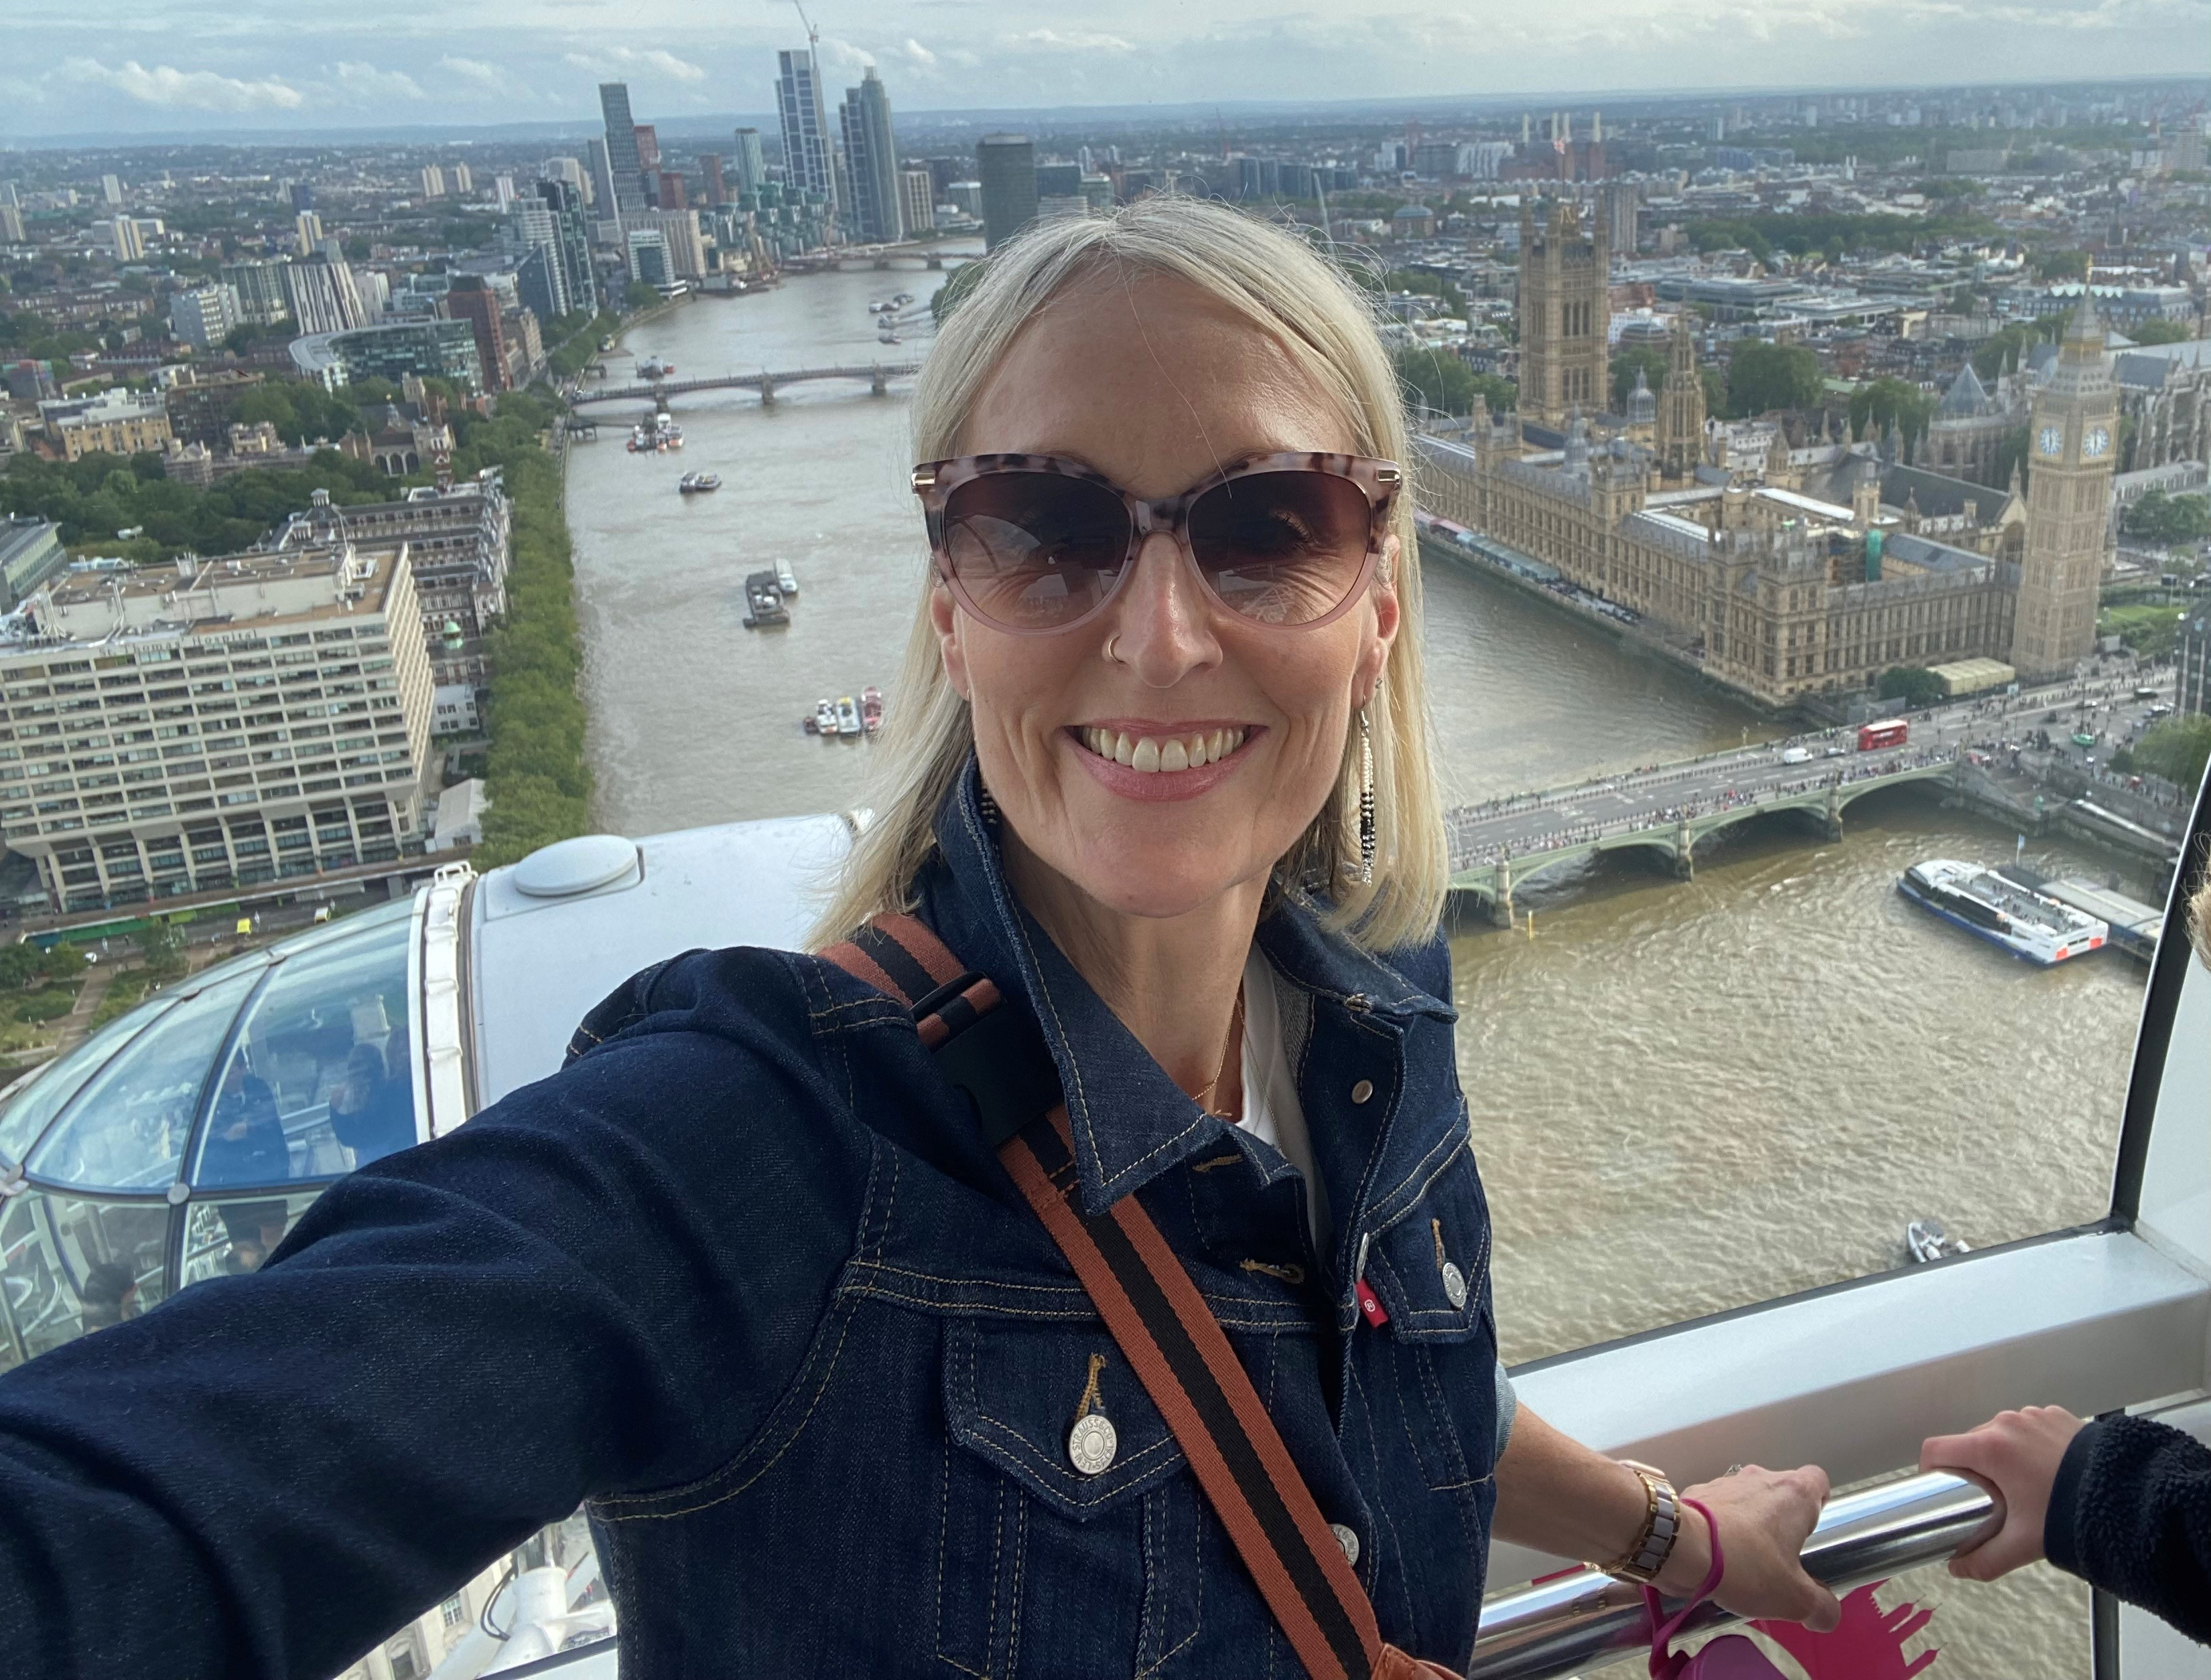
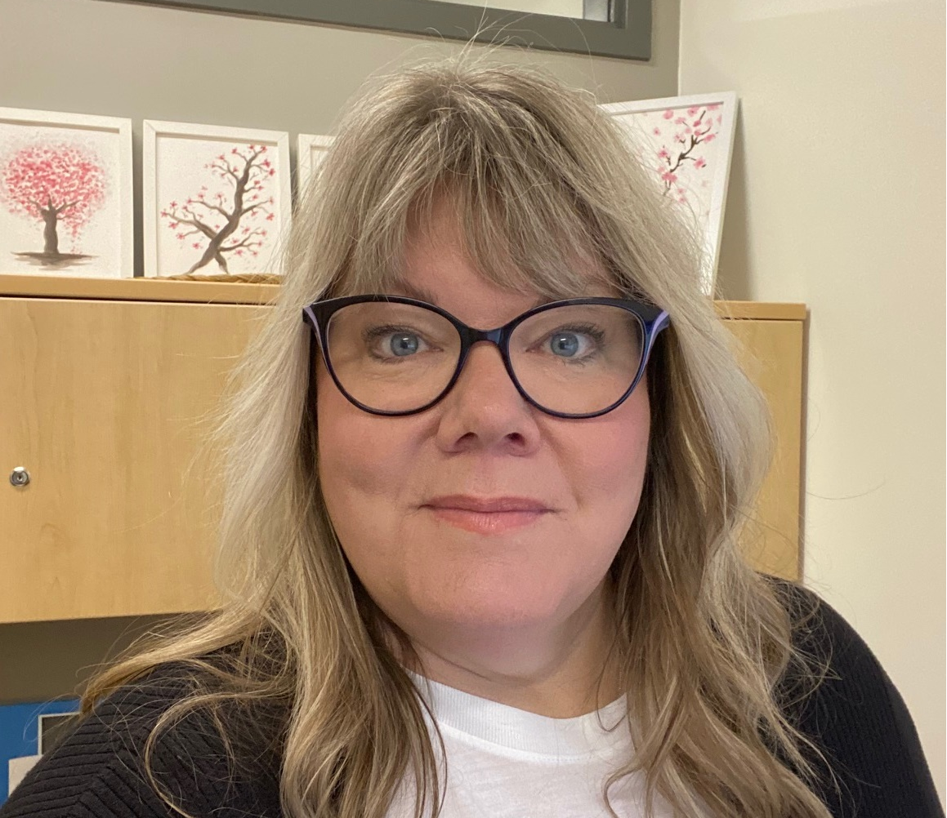
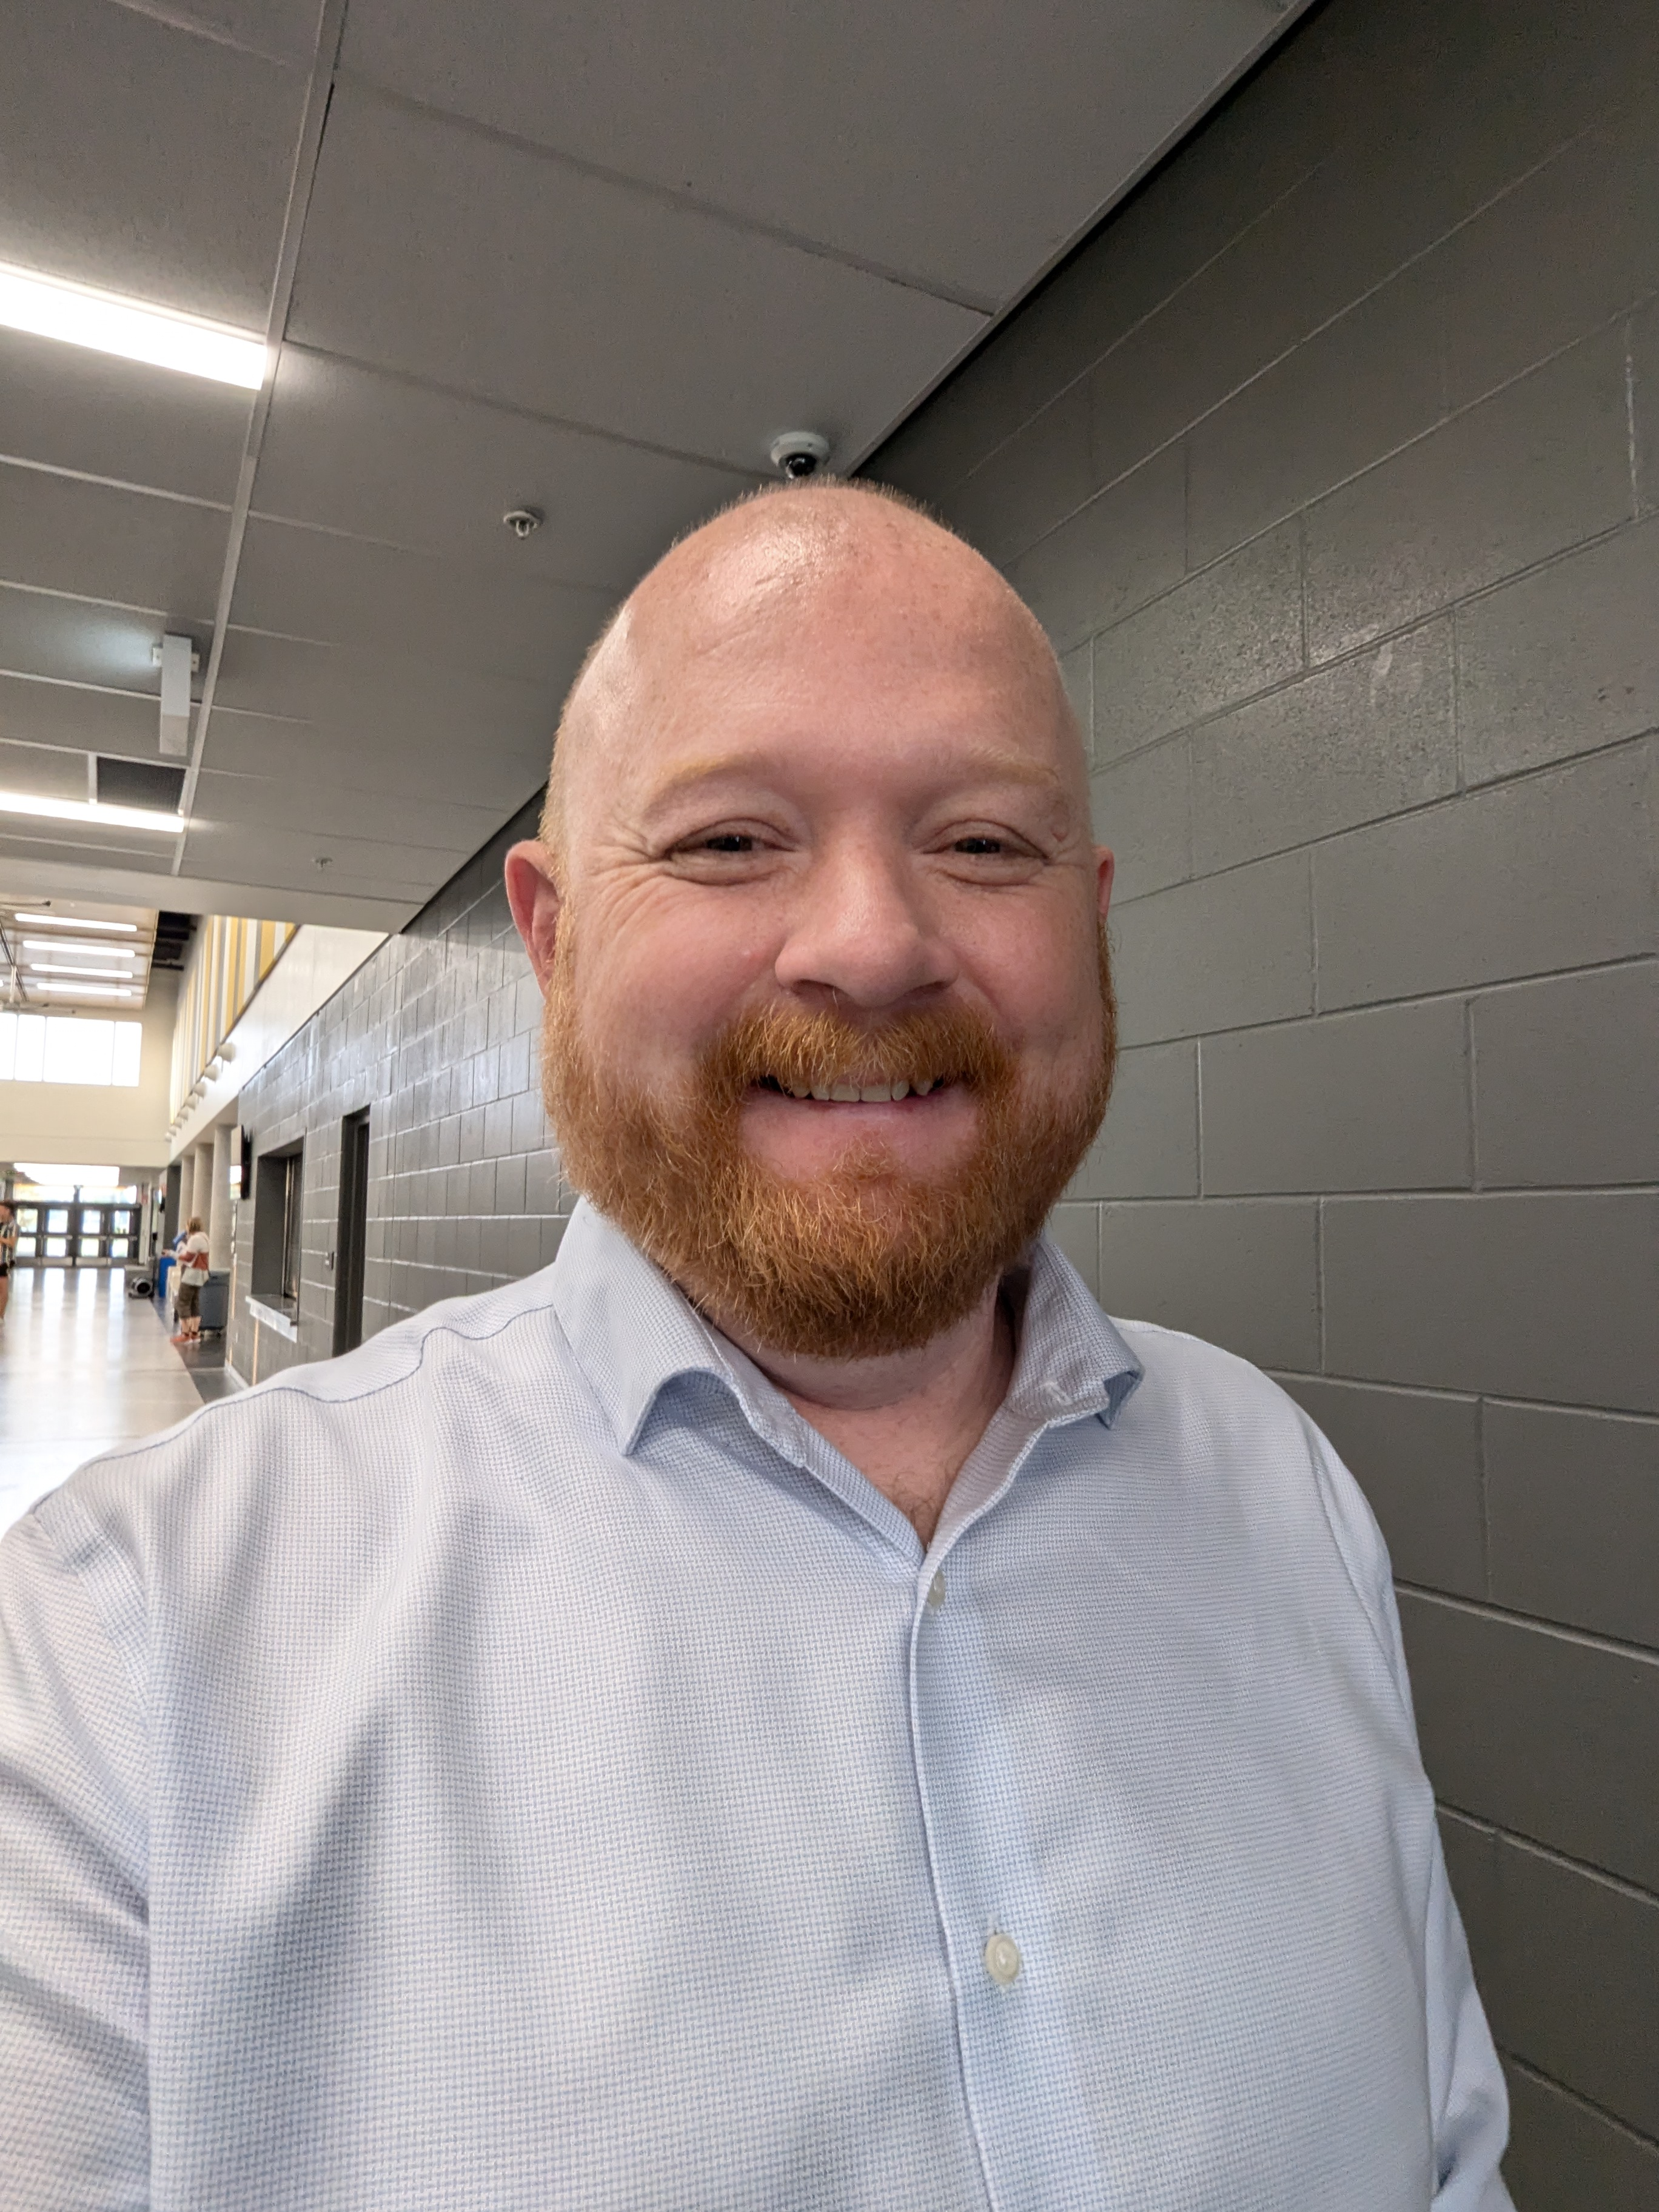
Jacqui Kroeker
Linda Eden
David Gamble
Your Admin Team
Notes:
We all work with all students but one administrator will be linked to the grade nines. Primary contact

Slide 4
Notes:
We have 5 Schools Joining the PTC community in grade nine. Students come from... list schools.

Slide 5
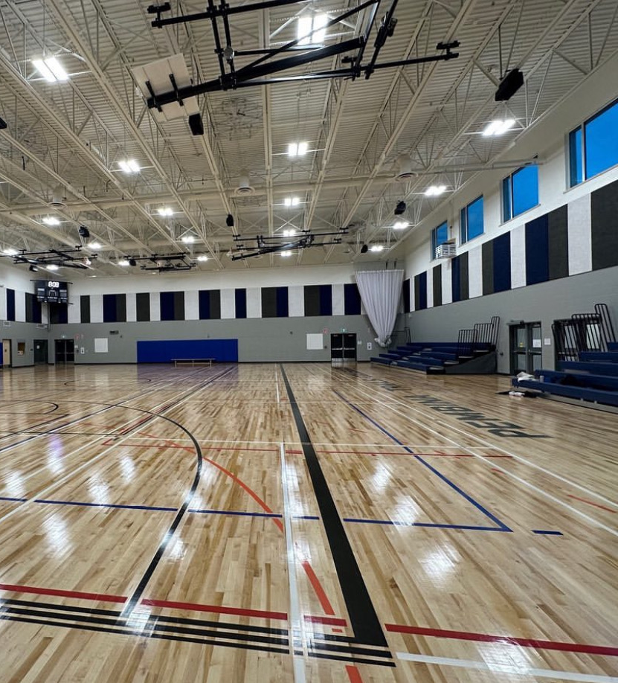
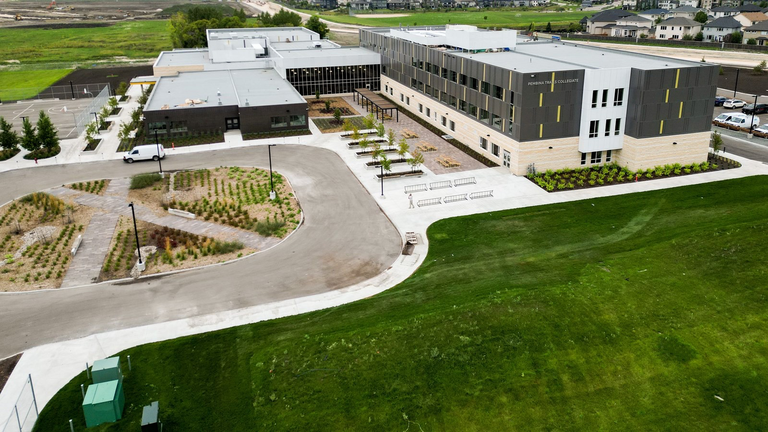
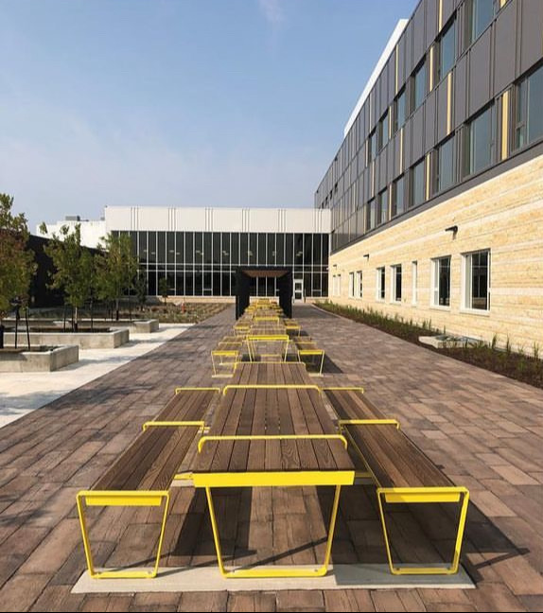
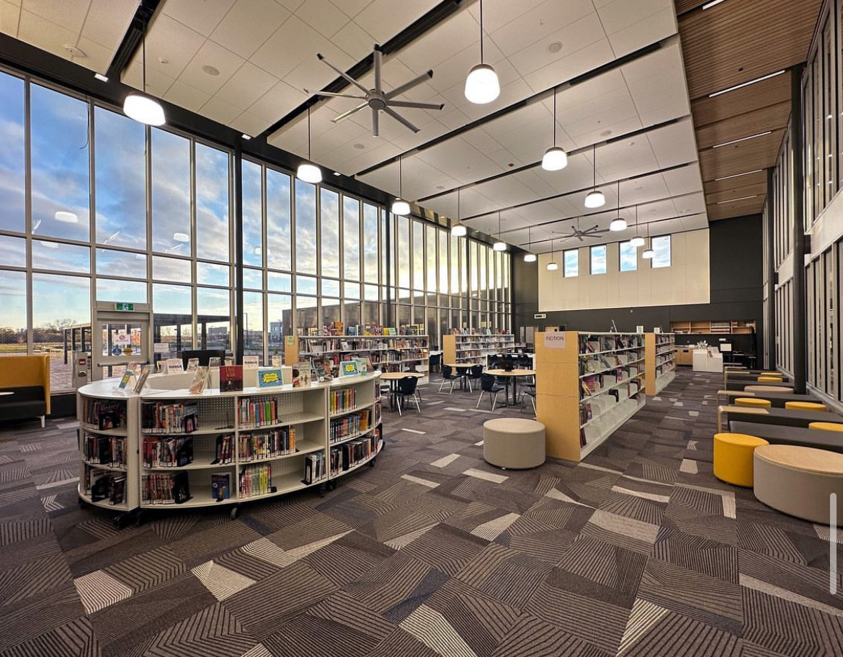
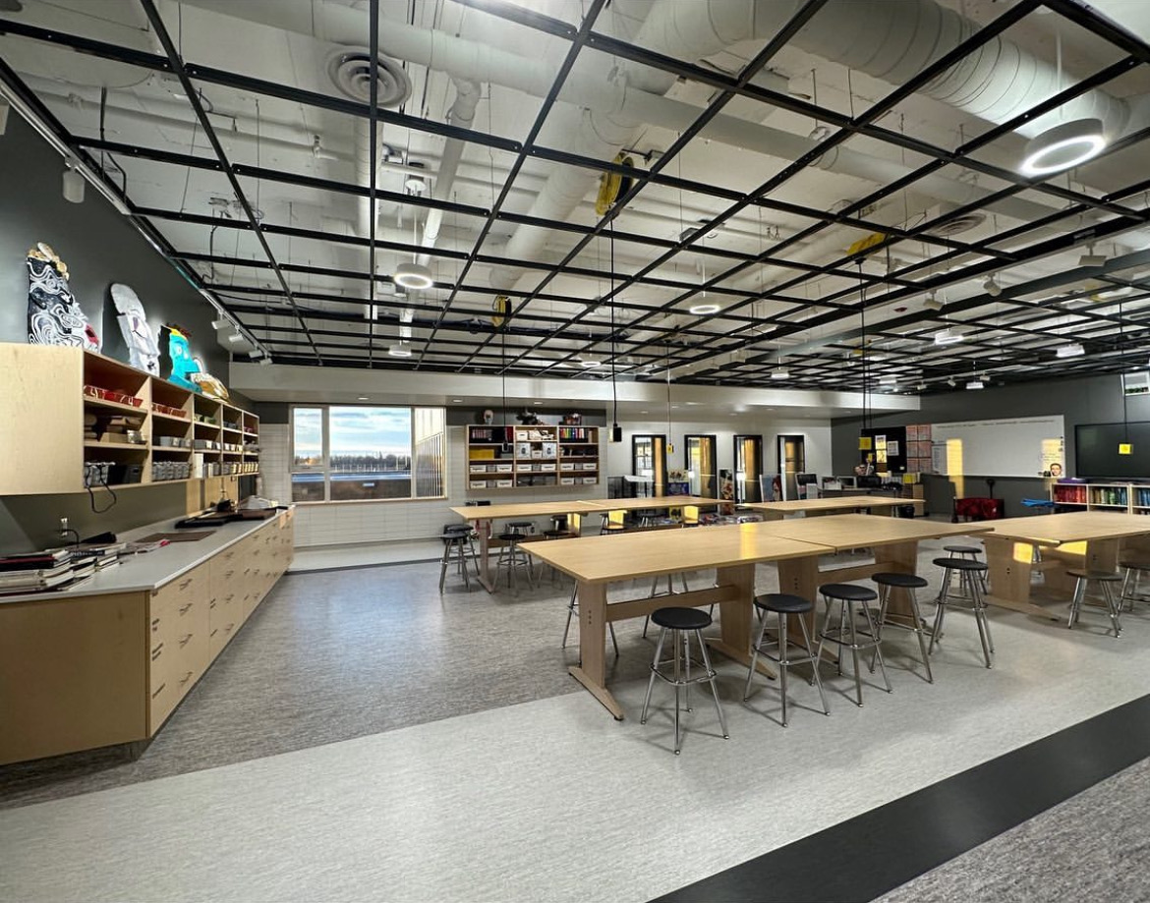
TRAILHAWKS Student Advisory Council
Notes:
We are going to start our presenation today with two of our current students who are part of our advisory council. Welcome to Aayan and Keaton who will be sharing some information with you.

Slide 6
Extracurricular Activities
Student Advisory Council
Esports
Sports Teams
Math Club
Much more!
Leadership Council
Key Club
Debate Club
Peer Tutoring
CyberPatriot Competition
Notes:
advisory

Slide 7
Notes:
advisory

Slide 8
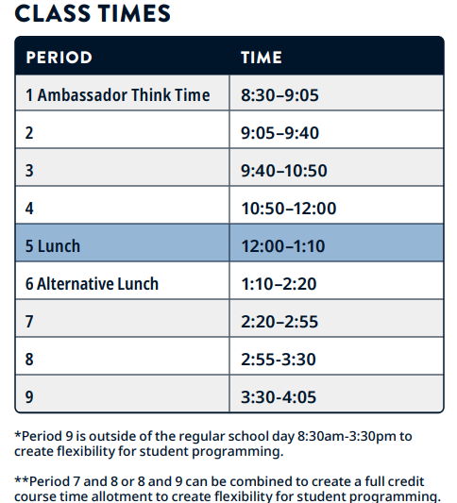
Timetable
Notes:
advisory

Slide 9
Assessments
Products, Conversations and Observations (Exams)
Notes:
advisory

Slide 10
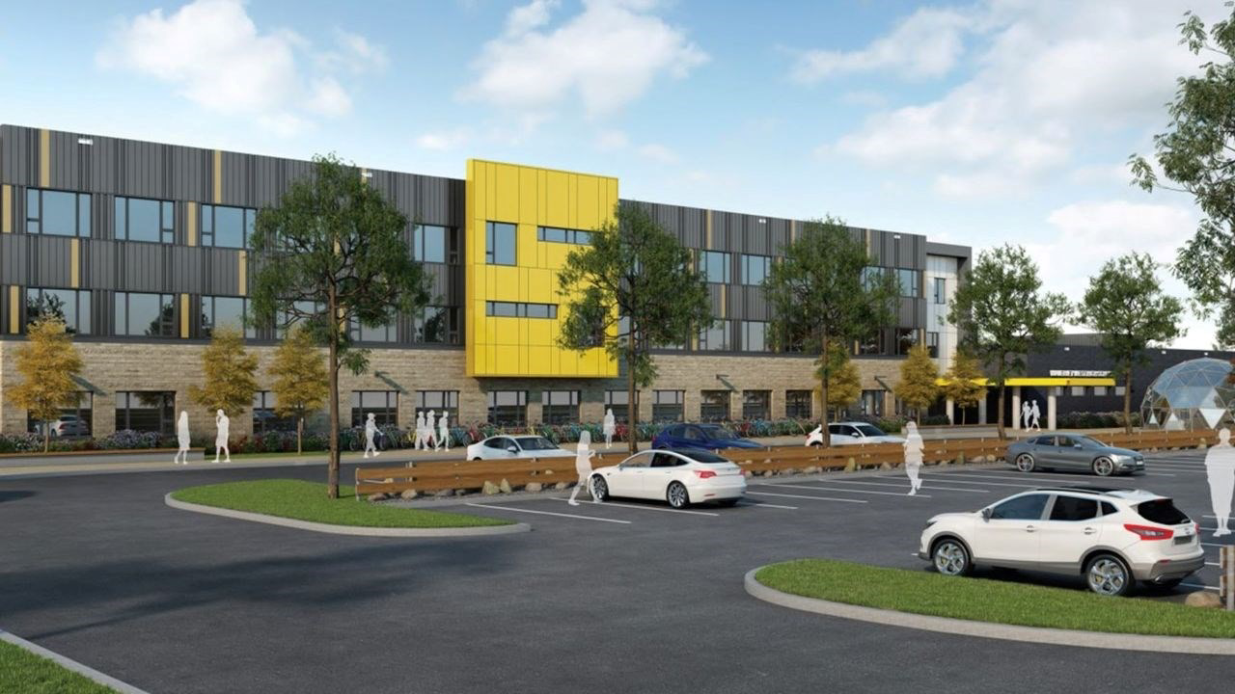
Where to be? Ptc.

Slide 11
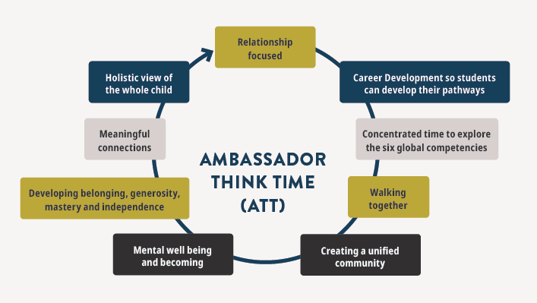
Notes:
This course runs all year Students will begin their day from 8:30-9:05am with Ambassador Think Time, or ATT. Each student will work towards a Career Development credit by attending this compulsory course. Each cohort of students during this time will keep their teacher lead for 2 years This will foster a community that is focused on relationships and will help us deliver on our motto – Creating Innovative Pathways for every student. Grade 9’s will work towards receiving a Lifework Exploration10S credit
students will explore careers and their own skills and attributes that they offer the world. As a community we will teach well being and well becoming strategies for all students as well as build a culture of learners that leave PTC with astrong sense of the six global competencies (critical thinking, creativity, citizenship, connection to self, communication and collaboration).

Slide 13
TEAMS & ID
Grade 9 ID
Grade 11 ID
Grade 10 ID
Social Studies
Science
ELA
Math All Year
Semesterised
PE
Expressive Arts / Applied Commerce / TechDev / Languages/ TVE / Tech Education
Geography
Science
ELA
Semesterised
Math/PE
Expressive Arts / Applied Commerce / TechDev / Languages/ TVE / Tech Education
Canadian History
ELA
Semesterised
Math/PE
Expressive Arts / Applied Commerce / TechDev / Languages/ TVE / Sciences / Tech Education / AP Capstone
Notes:
Linda 9 and 10 ID then 11 Canadian history and ELA are taught ID, then sciences break off into more specialized areas of focuc, Chem , Physics and Biology

Slide 14
Grade 9 Interdisciplinary Team

Slide 15
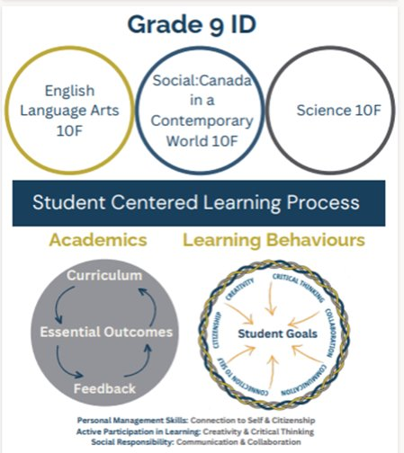
What is ID?
Interdisciplinary learning consists of teaching multiple subjects at once. It emphasizes the connections and transferable skills between all subject areas.
Notes:
Cam & Tracey

Slide 16
Why Interdisciplinary (ID)?
Students develop skills that can be used across all disciplines:
Collaboration, Critical Thinking,
Creativity, Communication,
Connection-to-self and Citizenship.

Slide 17
Notes:
Cam & Tracey

Slide 18
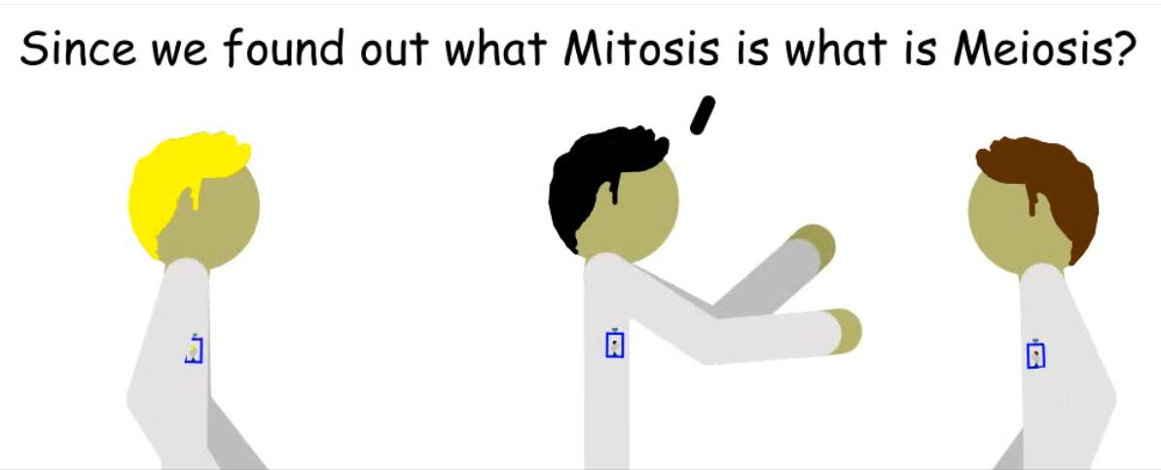
Another example: Students were given the challenge to "Show your knowledge of Meiosis in a Creative way, but link it to one of the Class Discussions we've had about a Social Studies topic."
Notes:
Cam & Tracey

Slide 19
Interdisciplinary Connections
"Stars and Story-Telling"
Grade 9 Science Learning: Celestial Bodies. Stars, Planets, Comets, Asteroids etc.
Grade 9 Social Studies Learning: Indigenous Culture. Stars as compass, calendar, and inspiration for traditional stories.
Grade 9 ELA Learning: How to structure and perform a story. Western point-of-view vs. Indigenous point-of-view.
Notes:
Erin & Neil

Slide 20
Structure of ID
In Grade 9 ID is taken all year long.
Students will finish with 3 Grade 9 credits – ELA10F, SCI10F, and SSCCW10F.
Topics (ELA, Science, Social Studies) are taught simultaneously.
Students will be assigned to a lead teacher.
Teachers work collaboratively in a pod with 3 teachers.
Notes:
Erin & Neil

Slide 21
Interdisciplinary Assessment
Notes:
Chels & Shuja

Slide 22
Assessment Happens in Two Main Ways: Formative & Summative
Formative Assessments - learning along the way, providing feedback to improve
Summative Assessments - final projects, tests, and essays demonstrating proficiency
Notes:
Chels & Shuja

Slide 23
How Do We Assess 3 Subjects?
Example Activity:​
Teams prepare for, develop and present a “Space Station” design and mission plan to be presented in a simulated global conference, where they will be graded on their ability to explain their mission purpose, scientific accuracy, and citizenship within a global context.​
Students are assessed on Science skills when using astronomy principles to justify their station’s location and mission purpose​
Students are assessed on Social Studies skills when researching international space agencies and develop diplomatic collaboration strategies.​
Students are assessed on ELA skills when they communicate their ideas effectively in a written report and oral presentation at a simulated global conference​
This demonstrates how we evaluate scientific accuracy, global awareness, and communication skills within one project by looking at how well students explain their design choices, justify international partnerships, and present their findings clearly.
Notes:
Chels & Shuja

Slide 24
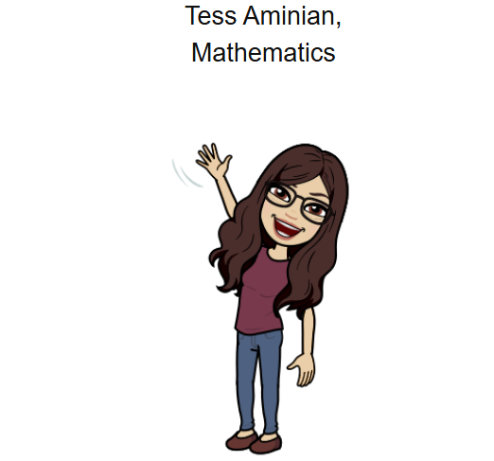
Grade Nine Mathematics
Notes:
Todd

Slide 25
Mathematics -2 Credits taken all year
TRANSITIONAL MATH 10F (MTR10F) & MATHEMATICS 10F (MATH10F)
(Taken concurrently).
Grade 9 Transitional Mathematics is a comprehensive program designed to bridge gaps in students’ mathematical comprehension during the transition from Grade 8 to Grade 9 Mathematics.
Notes:
Todd speaking

Slide 26
Mathematics
Notes:
Math – we review with students what skills and content they will learn in each of these areas, direct them to their interest and long term goals
Choose one math

Slide 27
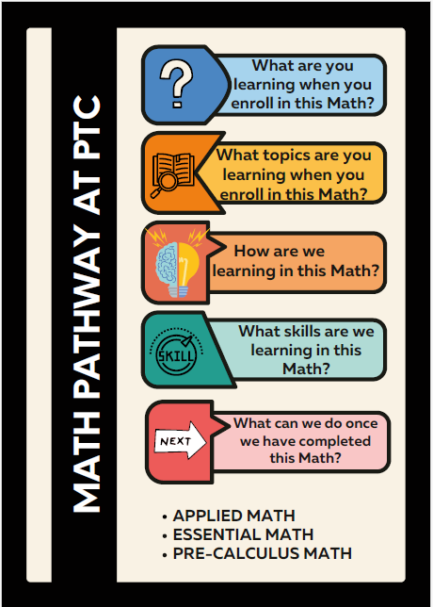
Notes:
Linda

Slide 28
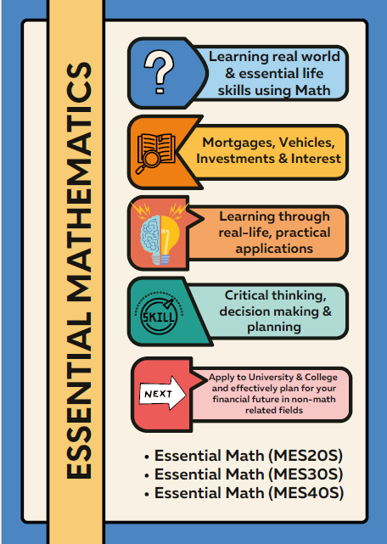
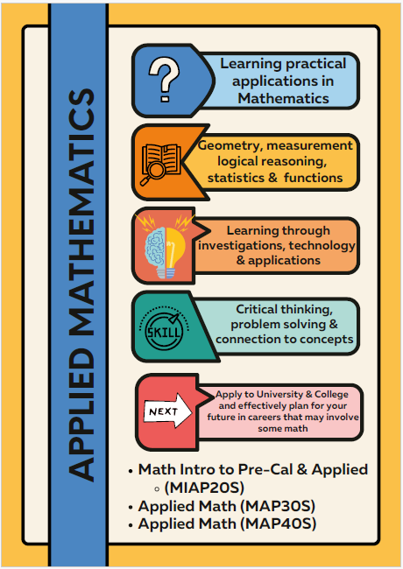
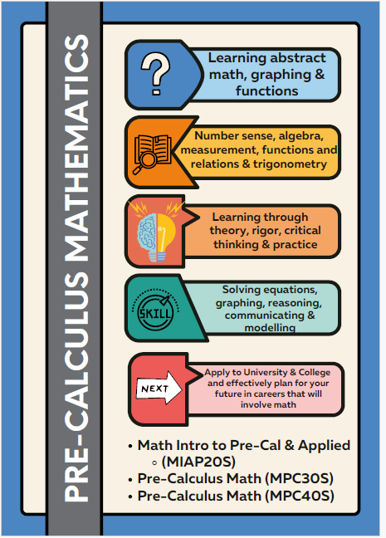
Notes:
linda

Slide 29
Student Handbook
Notes:
Linda- sources of information about courses,
https://www.pembinatrails.ca/ptcollegiate/page/16135/student-handbook
Update

Slide 30
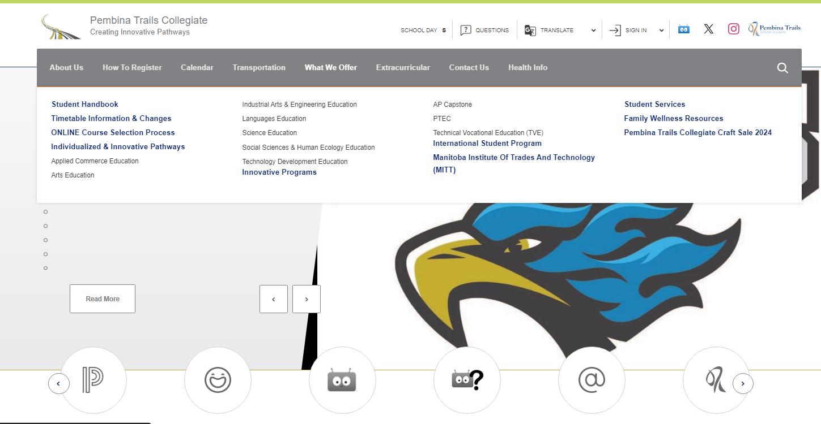
Student Handbook
Notes:
Sources of information for families
https://www.pembinatrails.ca/ptcollegiate/page/16135/student-handbook

Slide 31
Notes:
Graduation – 30 credits- 4 years to accomplish this

Slide 32
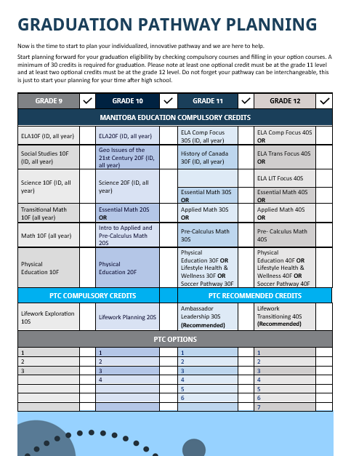
Notes:
Registration pckage UPdate

Slide 33
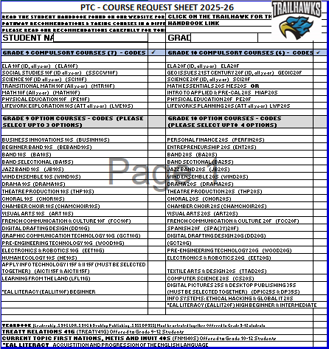
Notes:
Registration package to help you with your online registration update
Some courses are all year some are semesterized- Sept to End of January February to June

Slide 34
Grade Nine Electives
Students will request up to 3 Option courses
Notes:
Courses run based on interest, great time

Slide 35
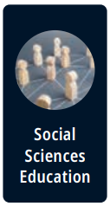
Business Innovations (BUSINN10S)
Band (BA10S & BA15S )
Jazz Band (JB10S)
Wind Ensemble (WIND10S must be in BA10S )
Beginner Band (BEBAND10S)
Drama (10S)
Theatre Production (THP10S)
Choir (10S)
Art (10S)
Human Ecology (HE10S)
Learning from the Land (LFL10G )

Slide 36
French Communication and Culture (FCC10F)
Spanish (SPA20F)
Applying Information & Communication Technology (AICTI15F & AICTII15F select together
(DPIC25S & DP35S select together)
Yearbook
Leadership and Print Communications
(LDR(.5)31G & PC25S select together)
Digital Drafting and Design (DDD10G)
Graphics (GCT10G)
Pre-Engineering Technology 10G (Woods10G)
Electronics and Robotics (EET10G )

Slide 37
Online Registration Feb 18-21
Grade 8 students return Student update form and course request sheets to their home school
PTC student services staff visit feeder schools
PTC staff to support in person on-line registration
Notes:
Next week

Slide 38
Student Services- Advisors
Role of student advisor
Edsby communication
Student support
Notes:
Ashley S. speaking

Slide 39
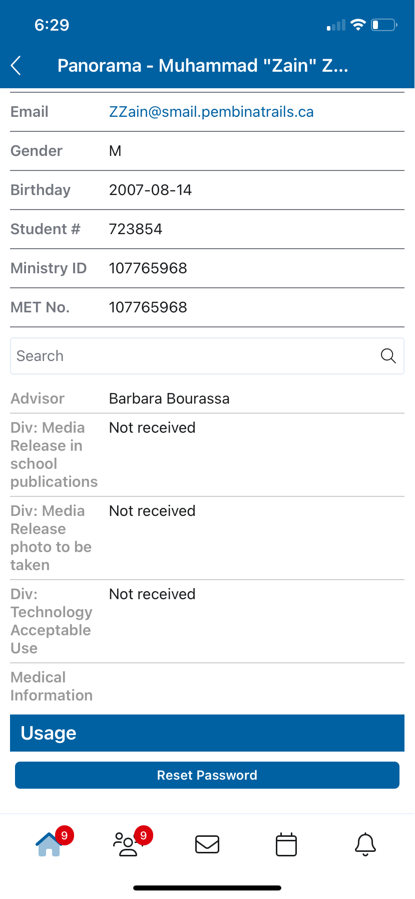
Student Advisor

Slide 40
Staggered Start Sept
3-5
All grades: Feast & Fair 5th starting strong as a community
All PTC students' timetables will be available to view in Edsby in August.
Tuesday, August 26 – Friday, August 29 at PTC by appointment only
TIMETABLES
TIMETABLE CHANGES
READY TO LEARN
Notes:
Your timetables will be available to view in Edsby in August. You will have chance to come to PTC and make adjustments the last week in August by appointment only with your student support teacher (listed as advisor on Edsby).

Slide 41
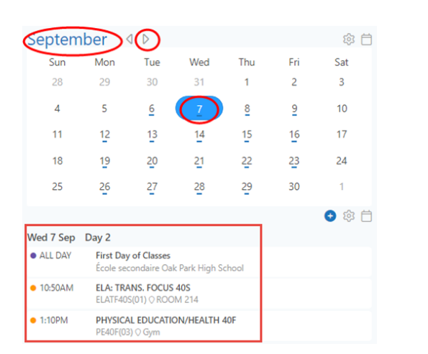
Where is my timetable in Edsby
Notes:
On a phone click the calendar icon at bottom of the phone – Change the date – to see second semester change the date to Feb 9th

Slide 42
Edsby – Home/ School Communication
Families sign up for Edsby
Connect with teachers and advisors
Classroom information
School announcements
Advisor
Attendance
Clubs and sport information
Notes:
Linda

Slide 43
Daily Life
Lockers
Cafeteria, microwaves
Independent learning( spares)
Open campus
Bussing
Drop off/Pick up
Clubs/ sports
Notes:
Building independence- working on the 6 C’s , transitioning

Slide 44
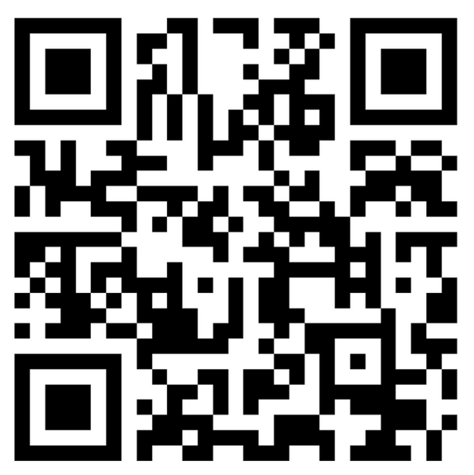
THANK YOU
Please make sure to send us any questions that you might have.
We hope you find that this presentation helps. :)
Notes:
A lot of information- Send a start up letter in August with reminders, calendar information and other important messages

