Slide 1
Social Media & Internet Safety
Principal’s Report to Parent Connection
February 20, 2024

Slide 2
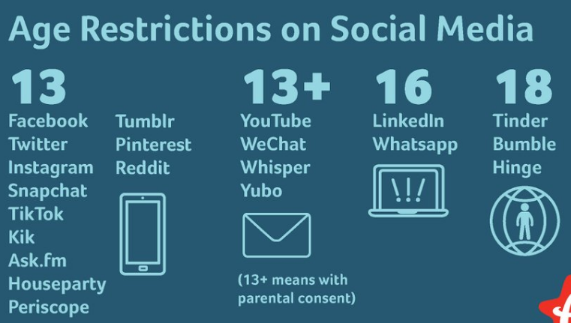
Did you know…
Minimum age to open an account on nearly every social media platform is age 13
Facebook
TikTok
Instagram
X (Twitter)
Pinterest
Kik
YouTube
SnapChat
Nearly 80% of 12-year-olds already have social media accounts

Slide 3
Did you know…
Apple’s CEO didn’t allow his children on social media.
Microsoft Founder and CEO didn’t give his children phones until they were 14.
Facebook’s former vice president doesn’t allow his children to use it.
Social Media platforms are designed for the adult brain
Algorithms, “likes”, “shares”, designed to release dopamine and create addiction
“Infinite Scroll” allows users to swipe endlessly without clicking on content

Slide 4
Research shows … (American Psychological Association, April 2023; U.S. Surgeon General May 2023; Canadian Mental Health Association June 2022)
Over 50% of teens report at least one symptom of clinical dependency on social media:
Insufficient sleep
Difficulties with attention
Stress regulation difficulties
Poor school performance
This is despite exposure to
Cyberbullying
Discrimination
Hate speech – racism
Promotion of self-harm

Slide 5
At Royal School …
Canadian Centre for Child Protection’s program Kids in the Know is used at all grade levels
“teaching effective personal safety strategies in an age-appropriate way … with a focus on resiliency and reducing likelihood of victimization in the online and offline world.”
Devices are not allowed to be brought to school. We provide devices in class
iPads in K-3
Laptops in 3-5
iPads and laptops in library
Telephone in every classroom

Slide 6
What can I do to help my child?
Talk with your children about how social media is not real life – there’s a lot of misinformation out there;
Talk with your children about minimum age requirements (13+) for social media;
Talk with your children about keeping private information private (private account, who are your friends/followers);
Talk with your children about where technology is allowed at home (family room? Kitchen table?);
Get Outside! Benefits of being outdoors in any weather;
Monitor time spent on social media – set screen-time limits, limit features;
Pediatric advice: no more than 1-hour daily screen time (total) co-viewing with parent for ages 2-8; no more than 2 hours screen time daily (total) for ages 9-17, except for homework.

Slide 7
More Resources for Families …
Canada’s Centre for Digital Media Literacy has created the Media Smarts website, with a collection of resources for parents:
For Parents | MediaSmarts
Website “ProtectKidsOnline.Ca” has a breakdown of online activities for ages 5-7, 8-10, 11-12, 13-15 that includes risks, parent supports for each age category.
Interests & Risks: 5–7 years of age – ProtectKidsOnline.ca
Common Sense Media for Families YouTube channel has a great collection of short videos to support online safety for children.
Example: 5 Internet Safety Tips for Kids

