Slide 2
INDUSTRIAL ARTS COURSES AT SHAFTESBURY

Slide 3
ELECTRICITY/ELECTRONICS TECHNOLOGY
TOPIC AREAS
OHMs LAW
COMPONENT IDENTIFICATION
RESISTOR COLOUR CODE
SCHEMATIC READING/DRAWING
BREADBOARD TESTING
ELECTRICAL THEORY
LOGIC CODING
PROBLEM SOLVING
PRODUCTION PROCESSES
SOLDERING PROJECTS
PRINTED CIRCUITBOARD CREATION
CIRCUITBOARD CASE CREATION
PROJECT MANUFACTUING
GAME CODING
MINDSTORM PROGRAMMING
ARDUINO PROGRAMMING
RASBERRY PI PROGRAMMING

Slide 4
GRAPHIC COMMUNICATION TECHNOLOGY
TOPIC AREAS
PRINCIPLES & ELEMENTS OF DESIGN
TECHNICAL DRAFTING/DRAWING
ADOBE PHOTOSHOP DESIGN
ADOBE ILLUSTRATOR DESIGN
DOCUMENT SETUP/LAYOUT
COMPOSITION LAYOUT/DESIGN
MULTI COLOUR LAYERED DESIGN
DESIGN FOR PRODUCTION
PRODUCTION PROCESSES
SCREEN PRINTING
VINYL CUTTING
SUBLIMATION PRINTING
AIRBRUSHING
DESKTOP PUBLISHING
PRINT MEDIA PACKAGING
BUTTON MAKING
DUCK TAPE ARTWORK

Slide 5
METALWORK TECHNOLOGY
TOPIC AREAS
WORKSHOP & MACHINE SAFETY
3D MODELLING
DESIGN FOR LASER ENGRAVING
DESIGN FOR CNC PLASMA CUTTING
DRAFTING/PROJECT DESIGN
MEASUREMENT & LAYOUT TECHNIQUES
MANUFACTURING PROCESSES
FINISHING APPLICATIONS
PRODUCTION PROCESSES
SHEET METAL MANUFACTURING
CNC PLASMA CUTTING
LASER ENGAVING/CUTTING
3D PRINTING
MACHINING (METAL LATHE)
METAL FORMING (HOT & COLD)
MIG WELDING
TAP & DIE THREADING

Slide 6
SO MANY PROJECTS…

Slide 7
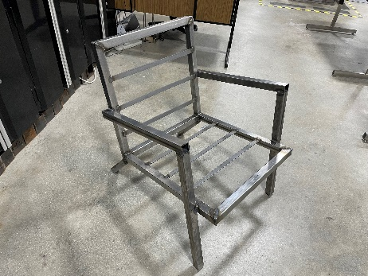
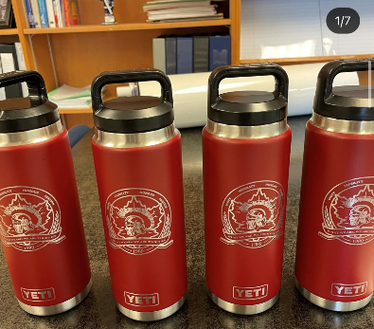
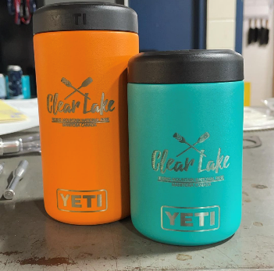
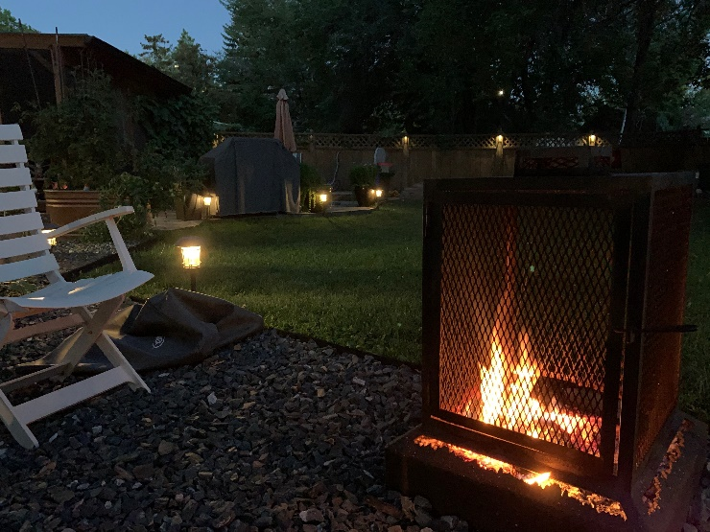
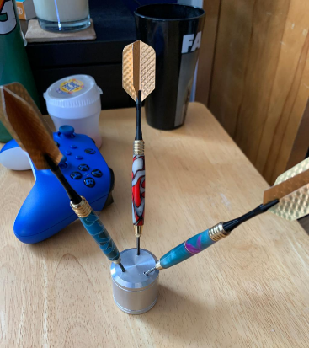
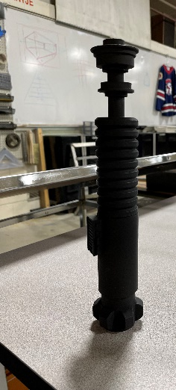
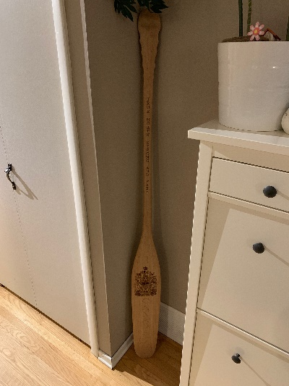
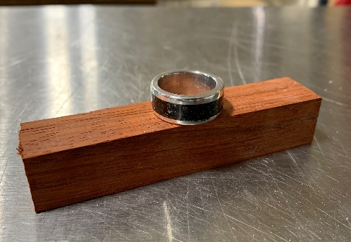
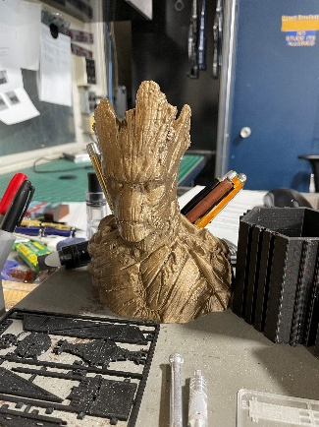
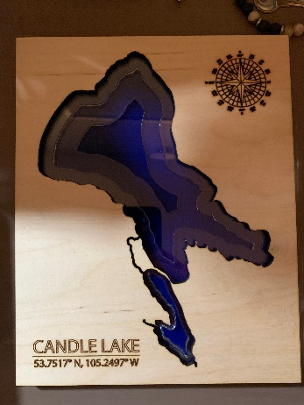
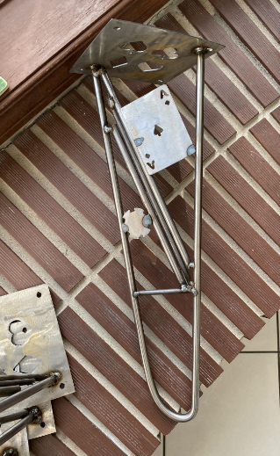
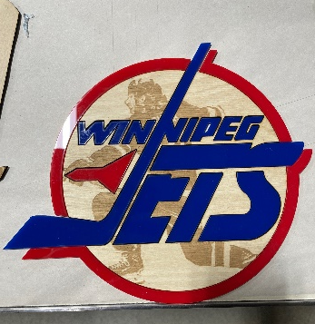
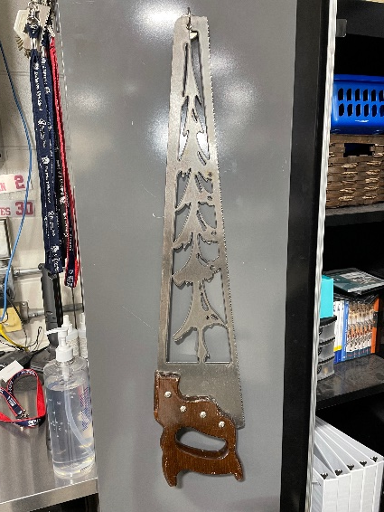
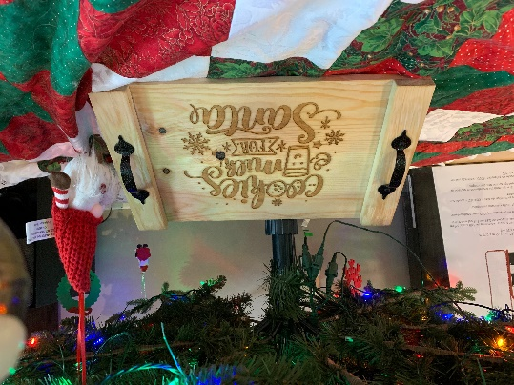
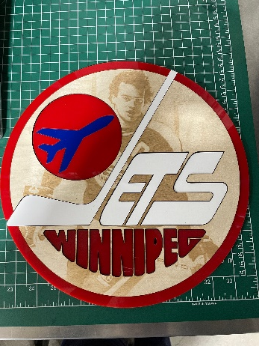
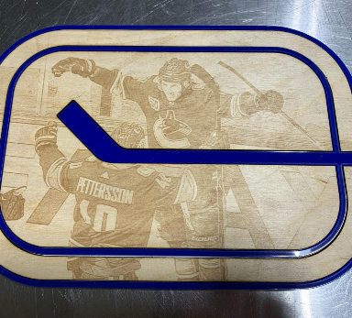
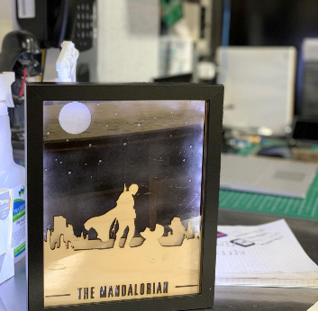

Slide 8
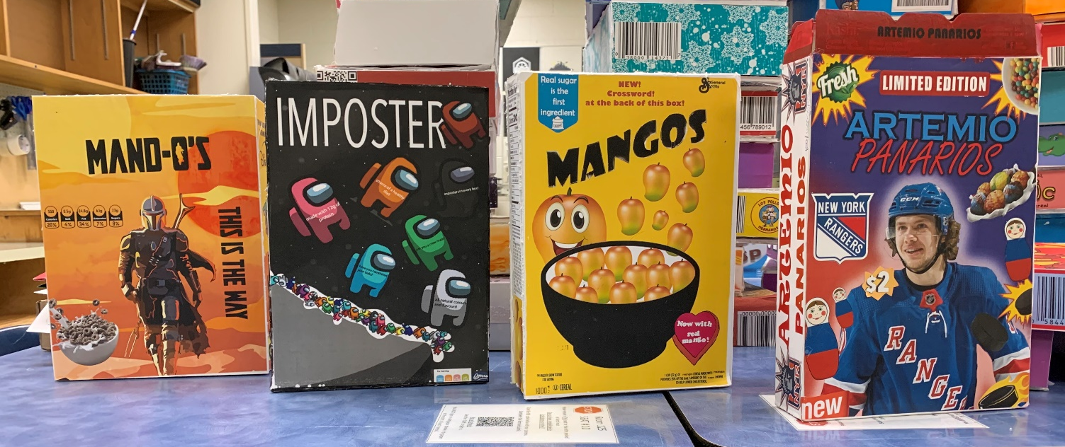
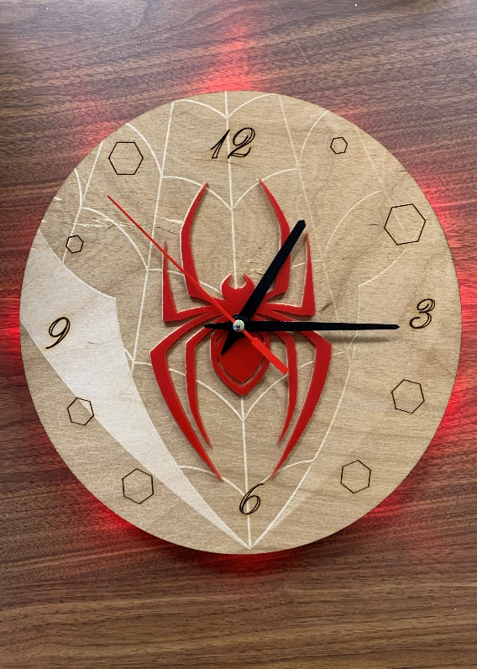
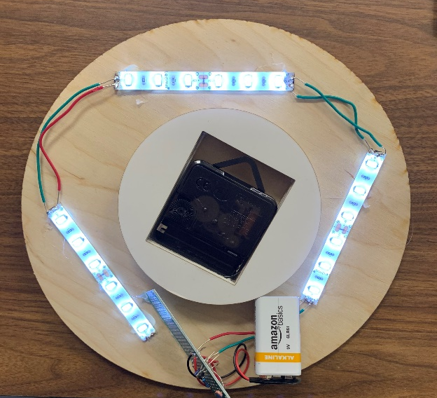
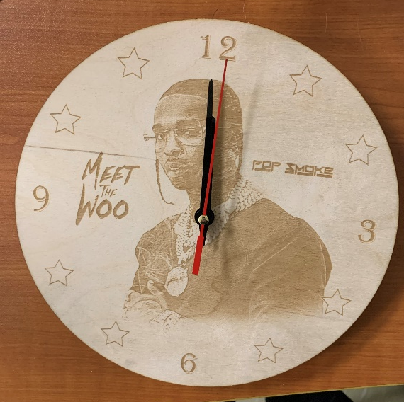
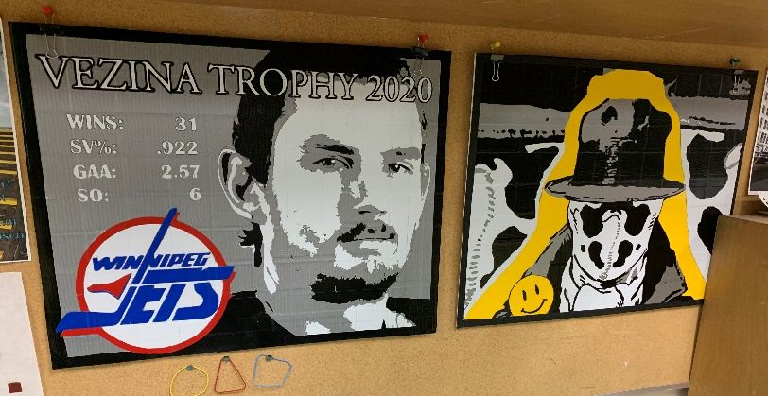

Slide 9
WATCH SOME OF OUR EQUIPMENT IN ACTION

Slide 10
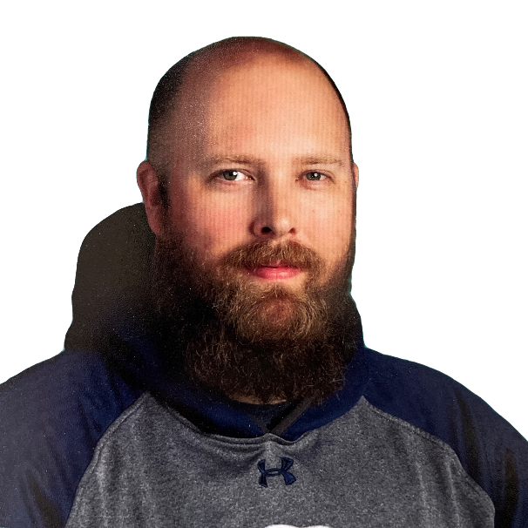
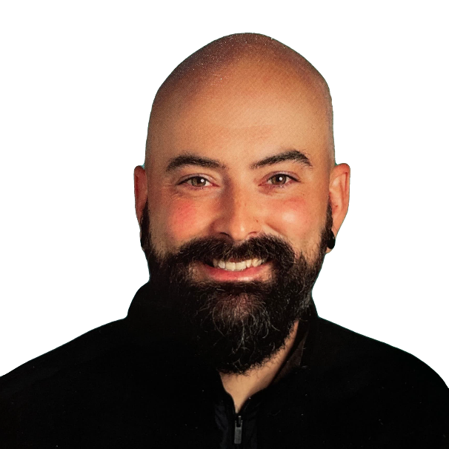
Mr. Plantje
Mr. Leithead
Mr. Plantje teaches metalworking and graphics.
He has over 14 years experience teaching Industrial Arts.
Mr. Plantje is one of the coaches for the boys hockey team.
Mr. Leithead teaches electronics and graphics.
He has over 5 years experience teaching Industrial Arts.
Mr. Leithead is one of the coaches for the ultimate and curling teams.

