Slide 1
Computer Science
Why Computer Science?
It’s fun and dynamic
You get to work in any industry of your choice: Healthcare, Education, Financial, Communications, Government sector…
What will I learn?
Learn to code with programming languages (C Sharp and Java)
Tools used: Microsoft’s Visual Studio and repl.it
Opens doors to limitless career opportunities
Learn problem solving and logical thinking skills
Explore careers in Computer Science

Slide 2
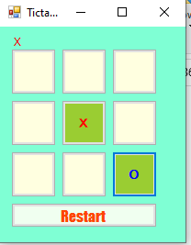
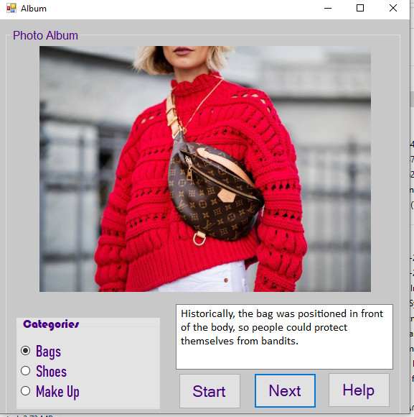
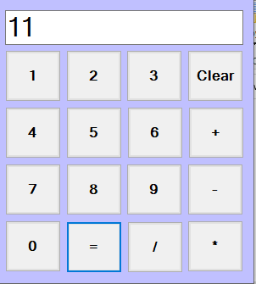
Computer Science
How will I learn?
Each student gets to apply the theoretical knowledge by creating fun projects such as Tic Tac Toe, Calculator, Photo album and more…

Slide 3
Computer Science
Where will I learn?
Shaftesbury has an excellent computer lab facility where each student gets hands-on coding experience
Mrs. Bains teaches Computer Science
Who will teach Computer Science?
She has 15 years of experience working in the IT industry and is able to provide real life applications of the course content

